Slide 1
EFFORT EXPENDITURE LINKS THE CONTROL OF VIGOR WITH DECISION-MAKING
Shruthi Sukumar¹, Reza Shadmehr² and Alaa Ahmed¹
University of Colorado Boulder¹
Johns Hopkins University²

Slide 2
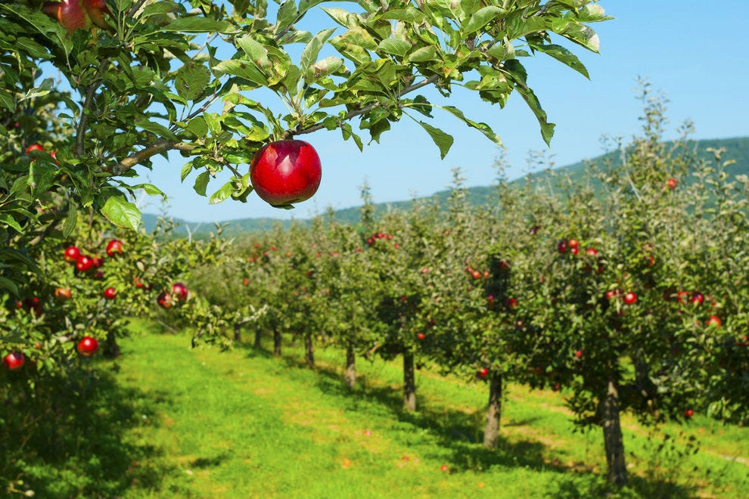
Apple-picking in an orchard
Notes:
Imagine yourselves picking apples in an orchard. It’s been a good orchard so far.

Slide 3
Apple-picking in an orchard
Notes:
You’ve had a good run of apple trees and have managed to collect lots of apples. One interesting question id: how long do you stay at one tree before moving on to the next.

Slide 4
Apple-picking in an orchard
Charnov 1976; Krebs, Ryan & Charnov 1974; Hayden, Pearson & Platt 2011; Constantino & Daw 2015;
Notes:
This type of stay or switch decision has been explored in length in ecology, computational psychology and neuroscience.
But let us think about another question: after you decide you’re done with a tree, how fast do you move to the next tree?

Slide 5
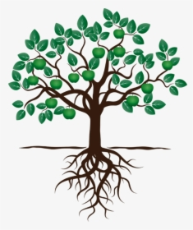
Apple-picking in an orchard
Charnov 1976; Krebs, Ryan & Charnov 1974; Hayden, Pearson & Platt 2011; Constantino & Daw 2015;
Notes:
But let us think about another question: after you decide you’re done with a tree, how fast do you move to the next tree?
Gary: don’t mention theory (OFT) or anything here

Slide 6
Apple-picking in an orchard
Charnov 1976; Krebs, Ryan & Charnov 1974; Hayden, Pearson & Platt 2011; Constantino & Daw 2015
Notes:
Now consider an alternate orchard where the run of apple trees hasn’t been as good. You now have to make a similar movement to that final, identical tree- are you going to move differently now because you had a bad run?
Traditional theories of motor control typically only consider effects of immediate requirements and rewards on vigor.

Slide 7
Does the quality of the environment modulate vigor of movements?
Notes:
But here, we are going to consider whether the quality of the environment in which you are moving change the vigor of your movement?

Slide 8
Optimal Foraging Theory
How do animals behave when foraging for food?
Notes:
For some answers, we turn to optimal foraging theory, a branch of ecology that studies how animals behave when they’re foraging for food in a habitat?

Slide 9
Optimal Foraging Theory
How do animals behave when foraging for food?
Considers a global capture rate that is being optimized.
Notes:
Often these theories consider a global rate of food capture and how the different behaviours affect them.

Slide 10
Optimal Foraging Theory
How do animals behave when foraging for food?
Considers a global capture rate that is being optimized.
In an environment with patchy food distribution, how do animals decide when to leave a patch?
Notes:
One of the main questions considered in this realm of study is – in a habitat or environment where food is distributed in clusters or patches, how do animals decide when to leave one patch of food for another?

Slide 11
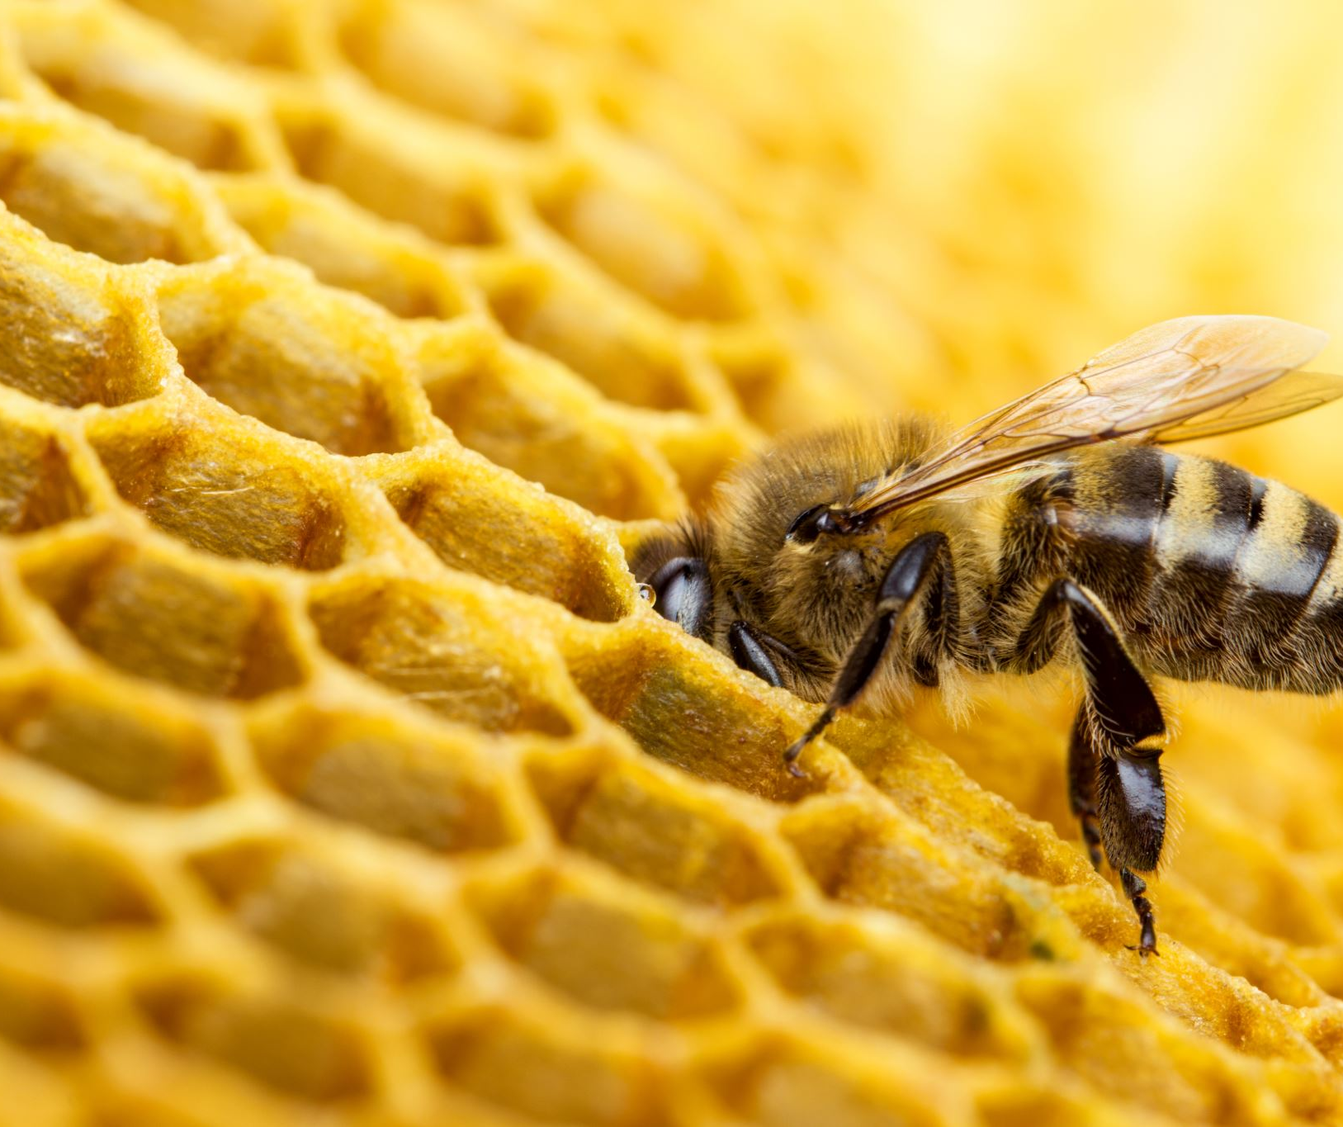
Optimal Foraging Theory
In an environment with patchy food distribution, how do animals decide when to leave a patch?
Charnov 1976
Notes:
We turn to optimal foraging theory for some answers. One question they consider in particular is
This is prescribed by Charnov in the seminal Marginal Value Theorem which states that an animal must leave a patch of reward when the capture rate within that patch equals the global capture rate of the environment.

Slide 12
The Marginal Value Theorem (MVT)
“ The predator must leave a patch it is presently in when the […] capture rate in the patch drops to the [global] capture rate for the habitat ”
- Eric Charnov 1976
Charnov 1976
Notes:
We turn to optimal foraging theory for some answers.One question they consider in particular is
This is prescribed by Charnov in the seminal Marginal Value Theorem which states that an animal must leave a patch of reward when the capture rate within that patch equals the global capture rate of the environment.

Slide 13
Global Capture Rate
Environment quality is defined by the global capture rate:
Charnov 1976
Notes:
Global capture rate determines the quality of the environment; high capture rate implies better environment. Therefore in a better apple orchard, your Jbar is higher

Slide 14
Global Capture Rate
Environment quality is defined by the global capture rate:
$$\overline{J}= \frac{Net Harvest −Movement Cost}{Total Time in Environment}$$
Charnov 1976
Notes:
Broadly, capture rate is defined (as in the equation) – total intake associated with all patches divided by total time in the environment
Alaa: this equation cam be more simplified
Gary: may need another slide next to link these terms to the math terms
Rachel : You could remove each term and add

Slide 15
Global Capture Rate
Environment quality is defined by the global capture rate:
$$\overline{J}=\frac{\sum_{n}{(f\left(t_{h}\right)−c)}}{\sum_{n}{(t_{h}+τ})}$$
Charnov 1976
Notes:
<Get into the specifics of each term. >
For now we’re going to keep the cost of movement constant (as Charnov does) and keep the travel duration as well fixed (pre-determined by environment)
Note to self:
Finish describing the terms and then touch upon the constant terms representing movement cost and movement duration

Slide 16
Global Capture Rate
Environment quality is defined by the global capture rate:
$$\overline{J}=\frac{\sum_{n}{(f\left(t_{h}\right)−c)}}{\sum_{n}{(t_{h}+τ})}$$
Net Harvest in Patch
Charnov 1976
Notes:
<Get into the specifics of each term. >
For now we’re going to keep the cost of movement constant (as Charnov does) and keep the travel duration as well fixed (pre-determined by environment)
Note to self:
Finish describing the terms and then touch upon the constant terms representing movement cost and movement duration
Need to say what th is when introducing f(th)

Slide 17
Global Capture Rate
Environment quality is defined by the global capture rate:
$$\overline{J}=\frac{\sum_{n}{(f\left(t_{h}\right)−c)}}{\sum_{n}{(t_{h}+τ})}$$
Net Harvest in Patch
Movement Cost
Charnov 1976
Notes:
<Get into the specifics of each term. >
For now we’re going to keep the cost of movement constant (as Charnov does) and keep the travel duration as well fixed (pre-determined by environment)
Note to self:
Finish describing the terms and then touch upon the constant terms representing movement cost and movement duration

Slide 18
Global Capture Rate
Environment quality is defined by the global capture rate:
$$\overline{J}=\frac{\sum_{n}{(f\left(t_{h}\right)−c)}}{\sum_{n}{(t_{h}+τ})}$$
Net Harvest in Patch
Movement Cost
Harvest Duration
Charnov 1976
Notes:
<Get into the specifics of each term. >
For now we’re going to keep the cost of movement constant (as Charnov does) and keep the travel duration as well fixed (pre-determined by environment)
Alaa:
Move the equation lower and then use arrows to annotate the terms
Note to self:
Finish describing the terms and then touch upon the constant terms representing movement cost and movement duration

Slide 19
Global Capture Rate
Environment quality is defined by the global capture rate:
$$\overline{J}=\frac{\sum_{n}{(f\left(t_{h}\right)−c)}}{\sum_{n}{(t_{h}+τ})}$$
Net Harvest in Patch
Movement Cost
Harvest Duration
Movement Duration
Charnov 1976
Notes:
<Get into the specifics of each term. >
For now we’re going to keep the cost of movement constant (as Charnov does) and keep the travel duration as well fixed (pre-determined by environment)
Note to self:
Finish describing the terms and then touch upon the constant terms representing movement cost and movement duration
Gary: asymmetry of the equation ; drop the (th) at this slide maybe

Slide 20
Classical MVT: When to leave a patch?
Global Capture Rate:
$$\overline{J}= \frac{\sum_{n}{(f\left(t_{h}\right)−c)}}{\sum_{n}{(t_{h}+τ})}$$
$f\left(t_{h}\right)$: Net Harvest In Patch
$t_{h}$: Harvest Duration
Charnov 1976
Notes:
Keeping in mind the global capture rate that we’re optimizing
let’s visualize Charnov’s prescription for when to leave. For this we focus on the net harvest within a patch.

Slide 21
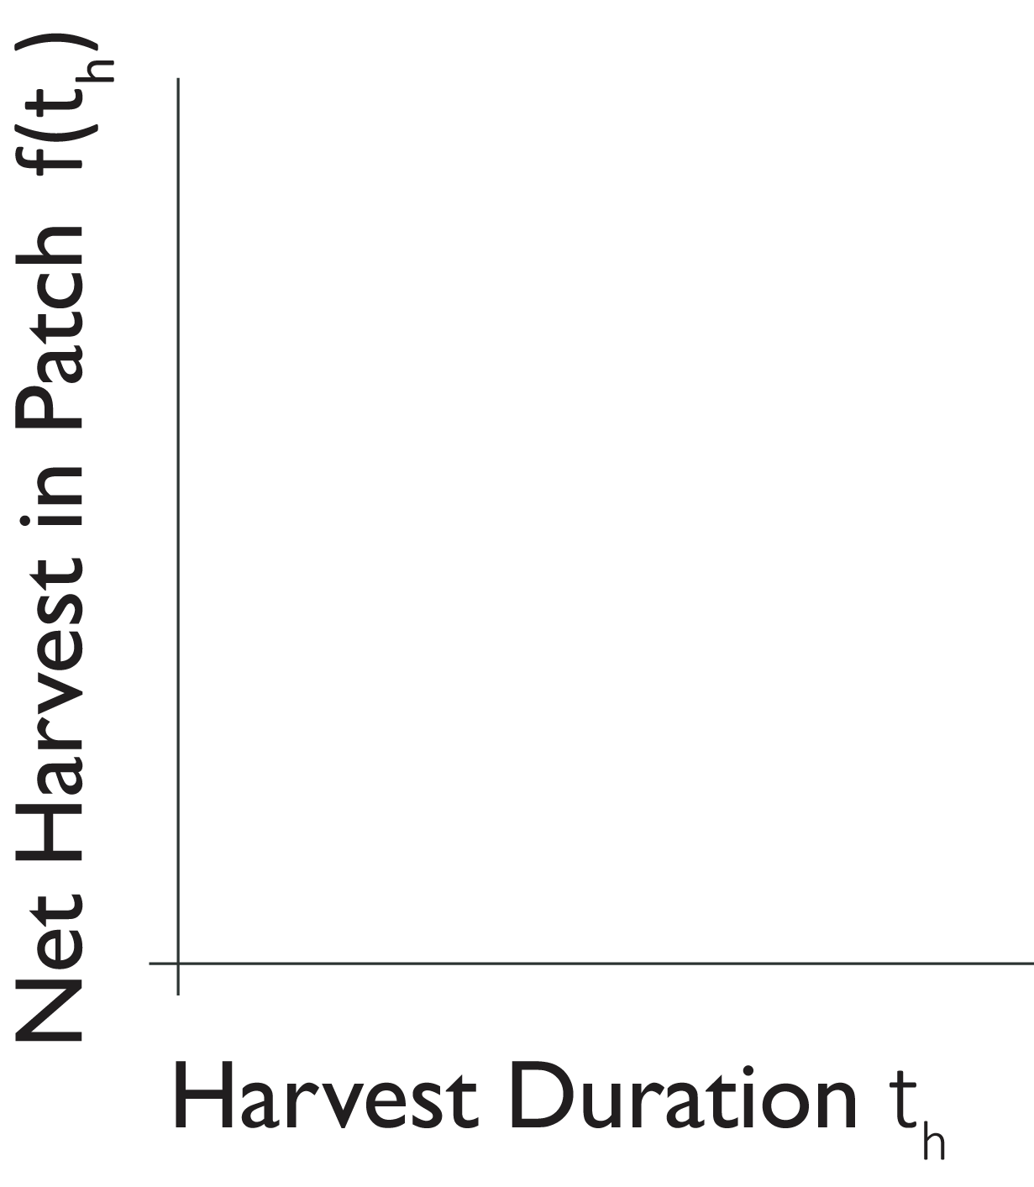
Classical MVT: When to leave a patch?
Global Capture Rate:
$$\overline{J}= \frac{\sum_{n}{(f\left(t_{h}\right)−c)}}{\sum_{n}{(t_{h}+τ})}$$
$f\left(t_{h}\right)$: Net Harvest In Patch
$t_{h}$: Harvest Duration
Charnov 1976
Notes:
Alaa:
Highlight that a patch is equivalent to the tree

Slide 22
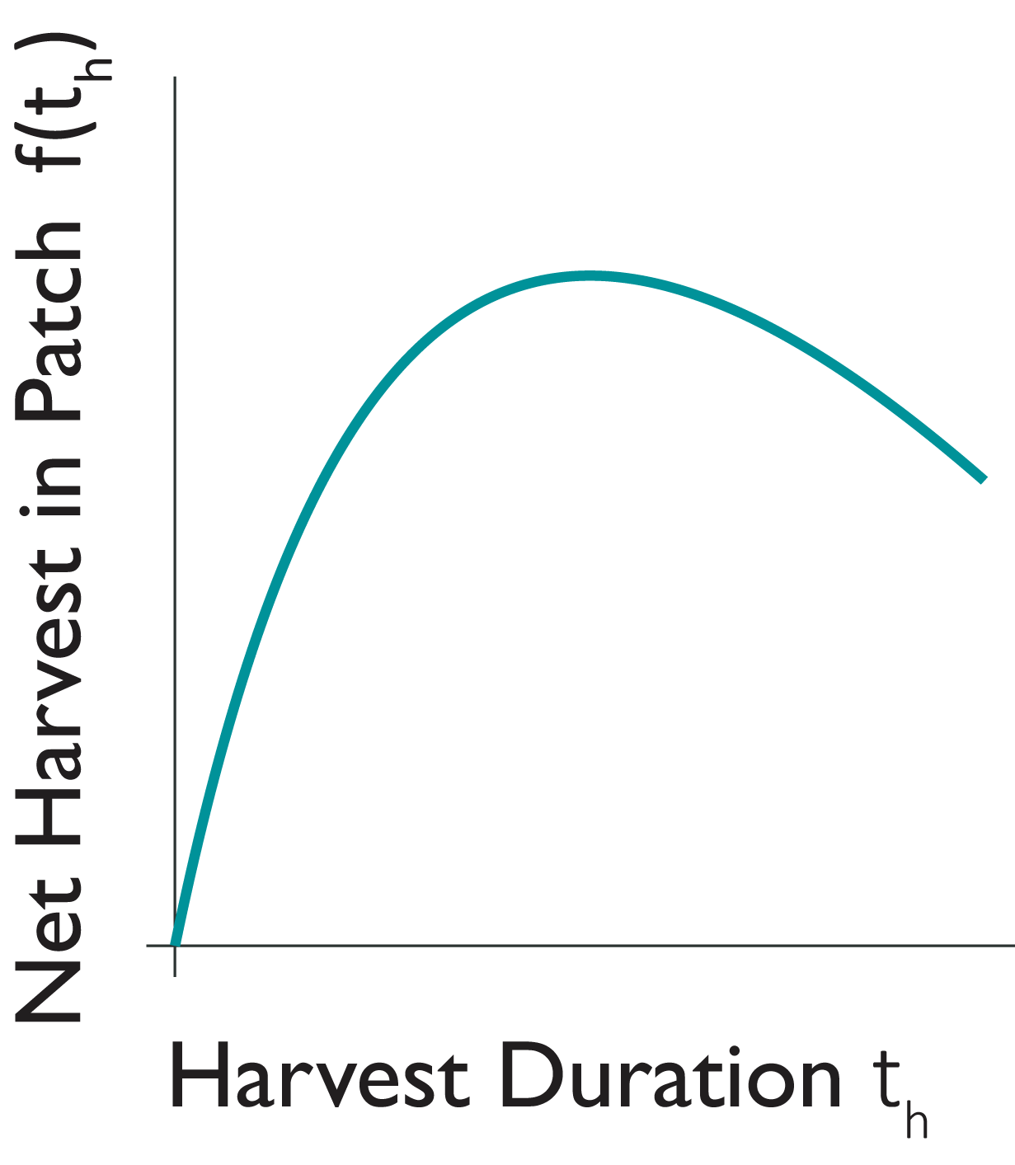
Classical MVT: When to leave a patch?
Global Capture Rate:
$$\overline{J}= \frac{\sum_{n}{(f\left(t_{h}\right)−c)}}{\sum_{n}{(t_{h}+τ})}$$
$f\left(t_{h}\right)$: Net Harvest In Patch
$t_{h}$: Harvest Duration
Charnov 1976
Notes:
<Pause here to explain the shape of the curve>
You can imagine that as a forager continues to harvest in a patch, the intake depletes. At some point, more energy is being invested than reward gained.

Slide 23
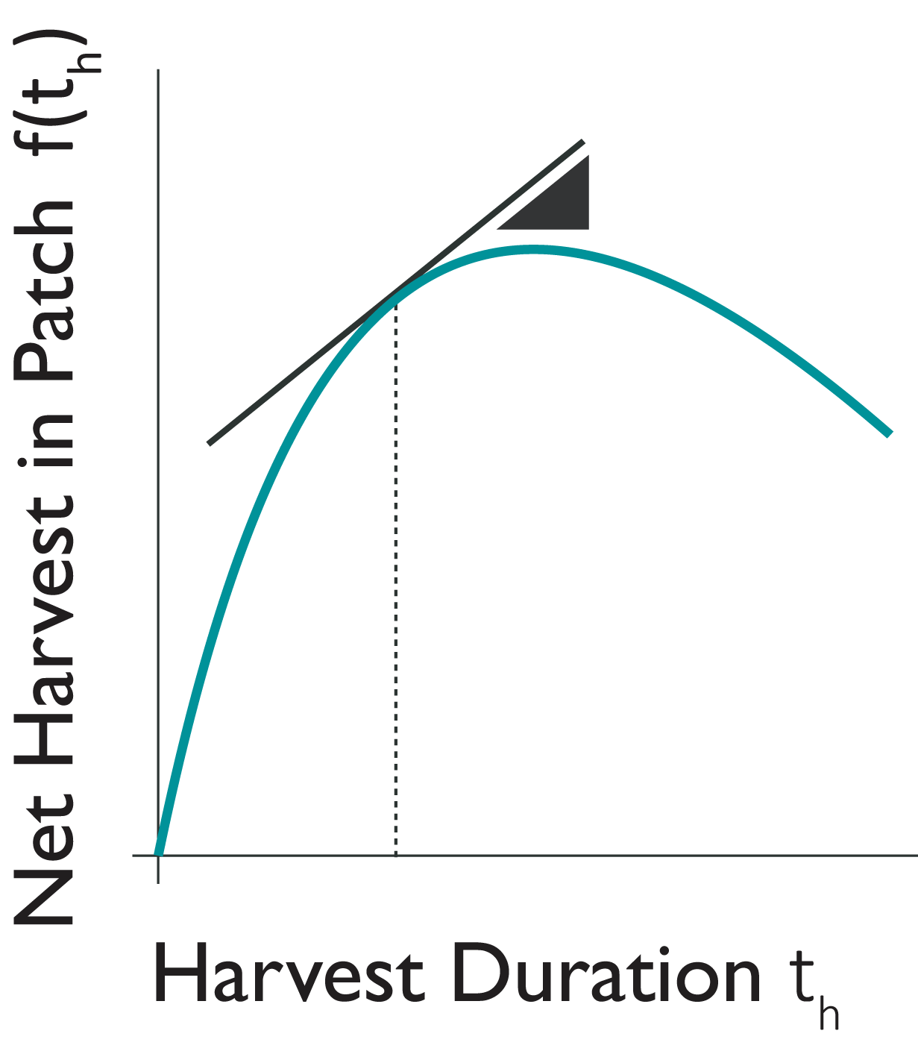
Classical MVT: When to leave a patch?
Global Capture Rate:
$$\overline{J}= \frac{\sum_{n}{(f\left(t_{h}\right)−c)}}{\sum_{n}{(t_{h}+τ})}$$
$f\left(t_{h}\right)$: Net Harvest In Patch
$t_{h}$: Harvest Duration
Charnov 1976
Notes:
MVT says that when the rate of harvest in a patch equals the global capture rate <move to next slide>

Slide 24
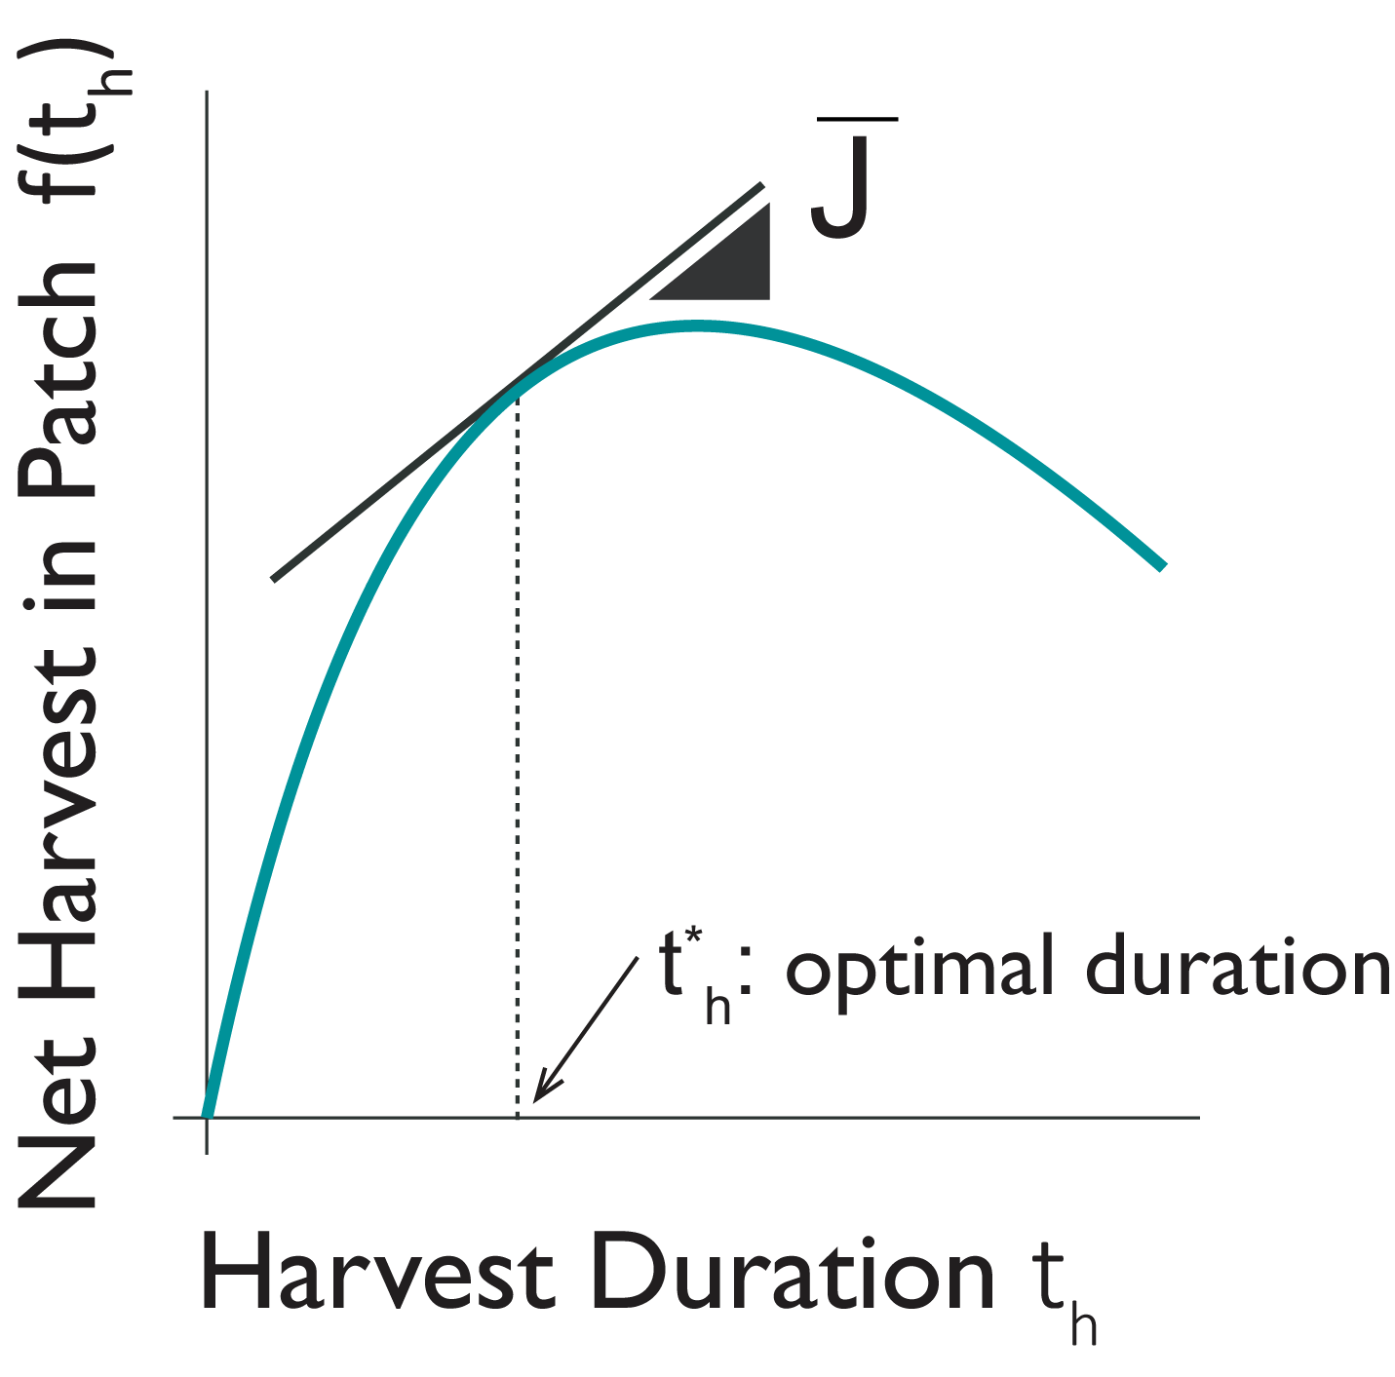
$\overline{J}$ dictates optimal harvest duration
Global Capture Rate:
$$\overline{J}= \frac{\sum_{n}{(f\left(t_{h}\right)−c)}}{\sum_{n}{(t_{h}+τ})}$$
Optimal Solution:
$$\overline{J} = {\left.\frac{∂f\left(t_{h}\right)}{∂t_{h}}\right|}_{t_{h}^{∗}}$$
Charnov 1976
Notes:
…forager must leave the patch. <point them to equation for clarity>
This theorem has been verified empirically in many fields to explain behaviour.
Alaa:
Anchor the subjects to what this means (poor and rich orchard)

Slide 25
$\overline{J}$ dictates optimal harvest duration
Global Capture Rate:
$$\overline{J}= \frac{\sum_{n}{(f\left(t_{h}\right)−c)}}{\sum_{n}{(t_{h}+τ})}$$
Optimal Solution:
$$\overline{J} = {\left.\frac{∂f\left(t_{h}\right)}{∂t_{h}}\right|}_{t_{h}^{∗}}$$
Assumption: Travel duration not selected to optimize $\overline{J}$
Charnov 1976
Notes:
…forager must leave the patch. <point them to equation for clarity>
This theorem has been verified empirically in many fields to explain behaviour.
Alaa:
Anchor the subjects to what this means (poor and rich orchard)

Slide 26
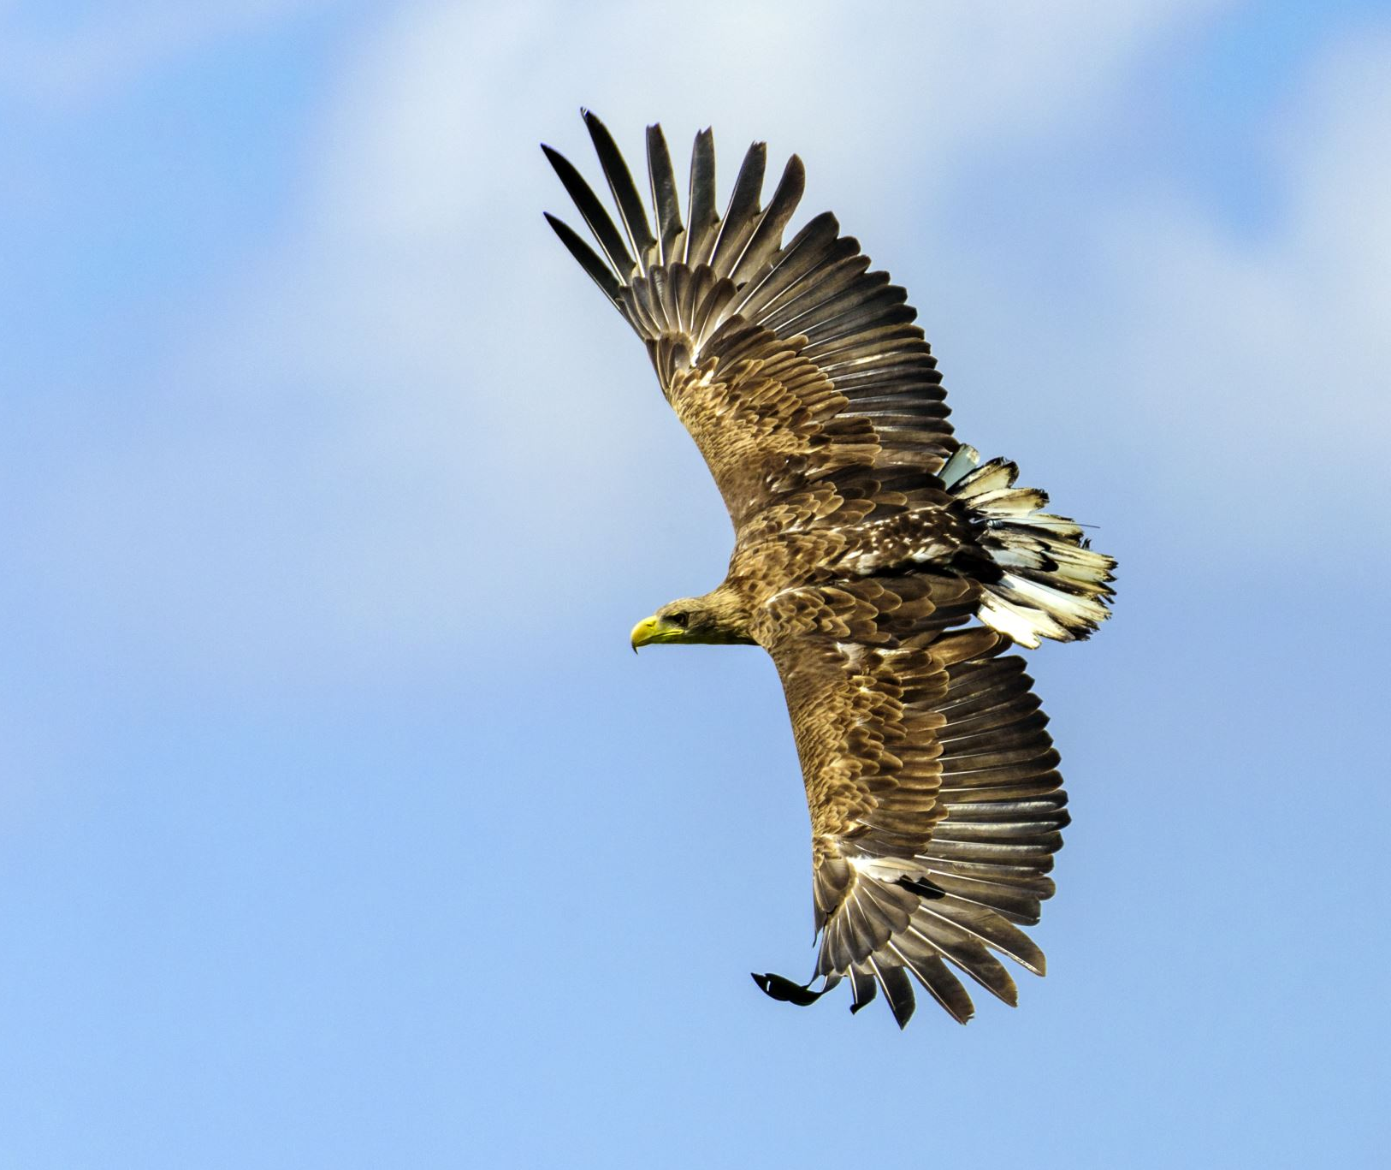
Generalized MVT
Travel duration or vigor is also chosen to optimize the global capture rate
$$\overline{J}= \frac{\sum_{n}{(f\left(t_{h}\right)−c)}}{\sum_{n}{(t_{h}+τ})}$$
Yoon et al, 2018
Notes:
Yoon and colleagues, consider the movement/travel duration or vigor between the patches as being selected to optimize the global capture rate as well.

Slide 27
Generalized MVT
Travel duration or vigor is also chosen to optimize the global capture rate
$$\overline{J}= \frac{\sum_{n}{(f\left(t_{h}\right)−c)}}{\sum_{n}{(t_{h}+t_{m})}}$$
Yoon et al, 2018
Notes:
We consider a different movement duration between any pair of patches (no longer pre determined)…

Slide 28
Generalized MVT
Travel duration or vigor is also chosen to optimize the global capture rate
$$\overline{J}= \frac{\sum_{n}{(f\left(t_{h}\right)−u\left(t_{m}\right))}}{\sum_{n}{(t_{h}+t_{m})}}$$
Yoon et al, 2018
Notes:
… and that this duration parametrized the cost of moving.

Slide 29
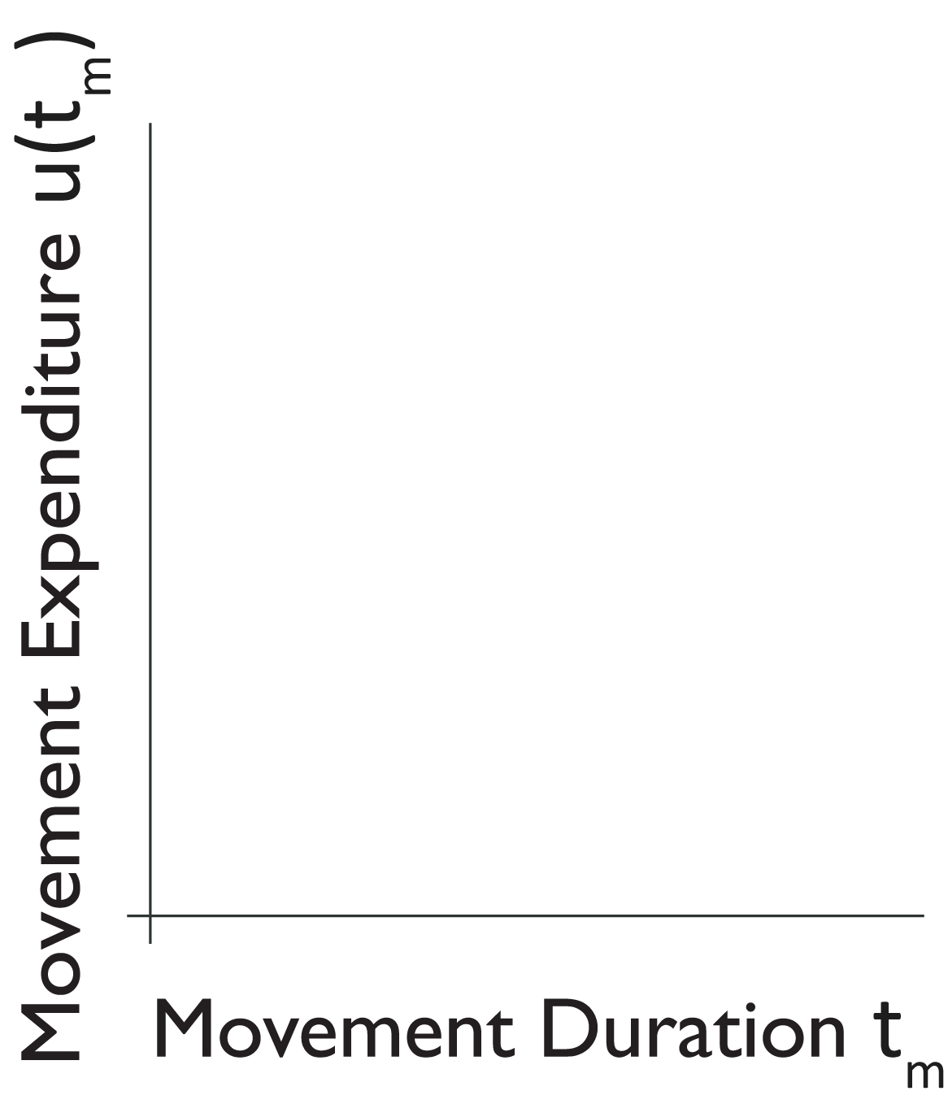
Generalized MVT: How fast to move on?
Global Capture Rate:
$$\overline{J}= \frac{\sum_{n}{(f\left(t_{h}\right)−u\left(t_{m}\right))}}{\sum_{n}{(t_{h}+t_{m})}}$$
$u\left(t_{m}\right)$: Movement Expenditure
$t_{m}$: Movement Duration
Yoon et al, 2018
Notes:
Generalized MVT prescribes the movement duration as follows. <highlight x and y axis>

Slide 30
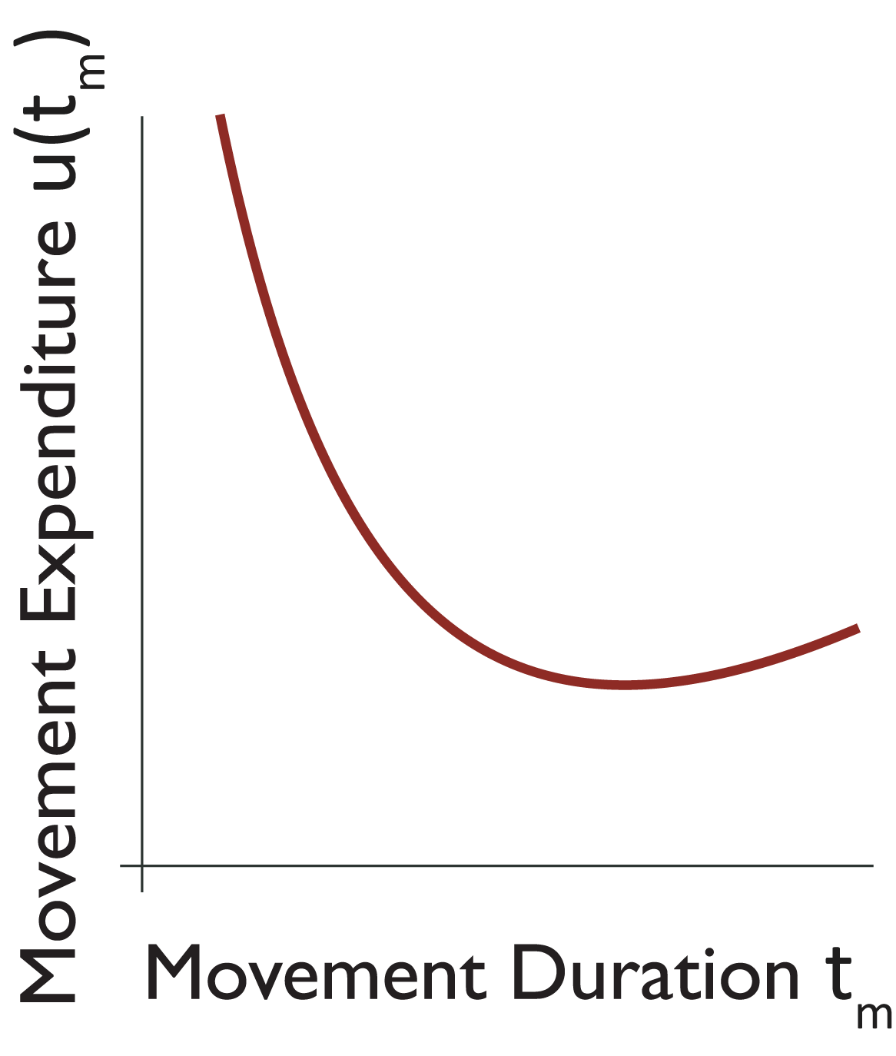
Generalized MVT: How fast to move on?
Global Capture Rate:
$$\overline{J}= \frac{\sum_{n}{(f\left(t_{h}\right)−u\left(t_{m}\right))}}{\sum_{n}{(t_{h}+t_{m})}}$$
$u\left(t_{m}\right)$: Movement Expenditure
$t_{m}$: Movement Duration
Yoon et al, 2018
Notes:
Movement expenditure as a function of time resembles this shape; as you move faster (mvt dur decreases) the cost of the movement increases.
Do you move according to the minimum?
Rachel: add visual aid (arrow) to explain shape (vigor/duration confusion)

Slide 31
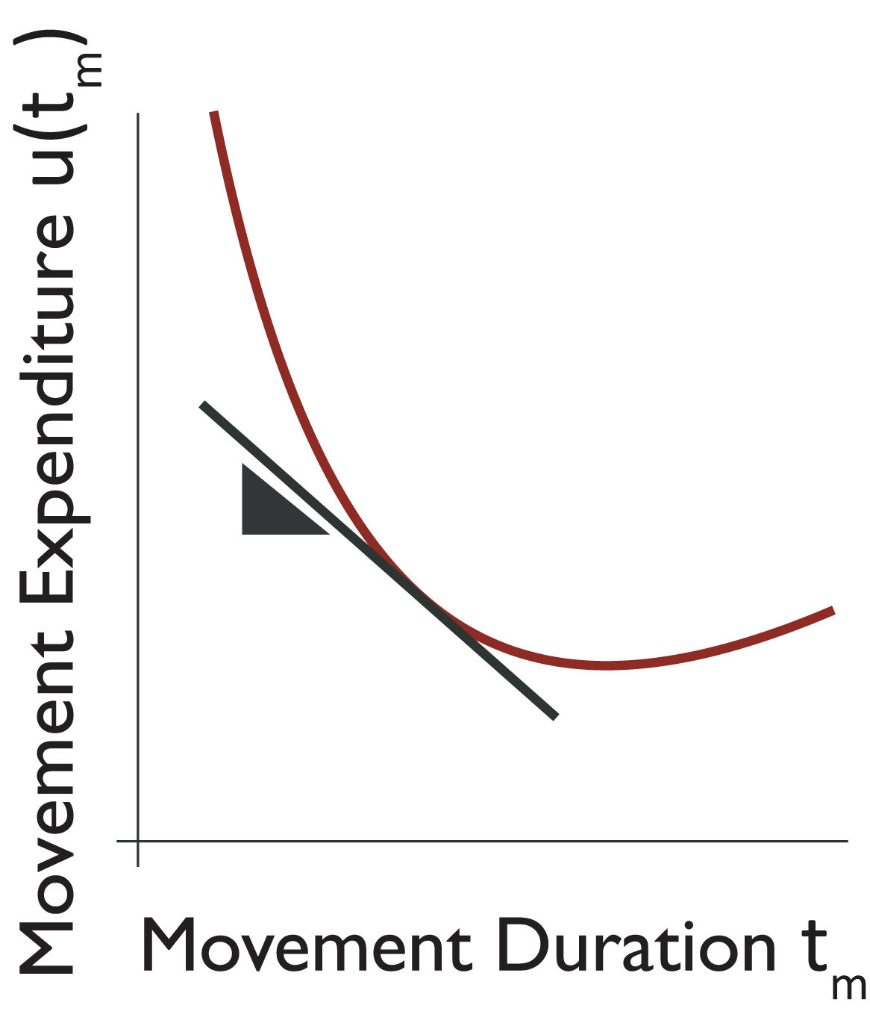
$\overline{J}$ also dictates movement vigor
Global Capture Rate:
$$\overline{J}= \frac{\sum_{n}{(f\left(t_{h}\right)−u\left(t_{m}\right))}}{\sum_{n}{(t_{h}+t_{m})}}$$
$u\left(t_{m}\right)$: Movement Expenditure
$t_{m}$: Movement Duration
Yoon et al, 2018
Notes:
Generalized MVT prescribes that when the rate of expenditure equals global capture rate

Slide 32
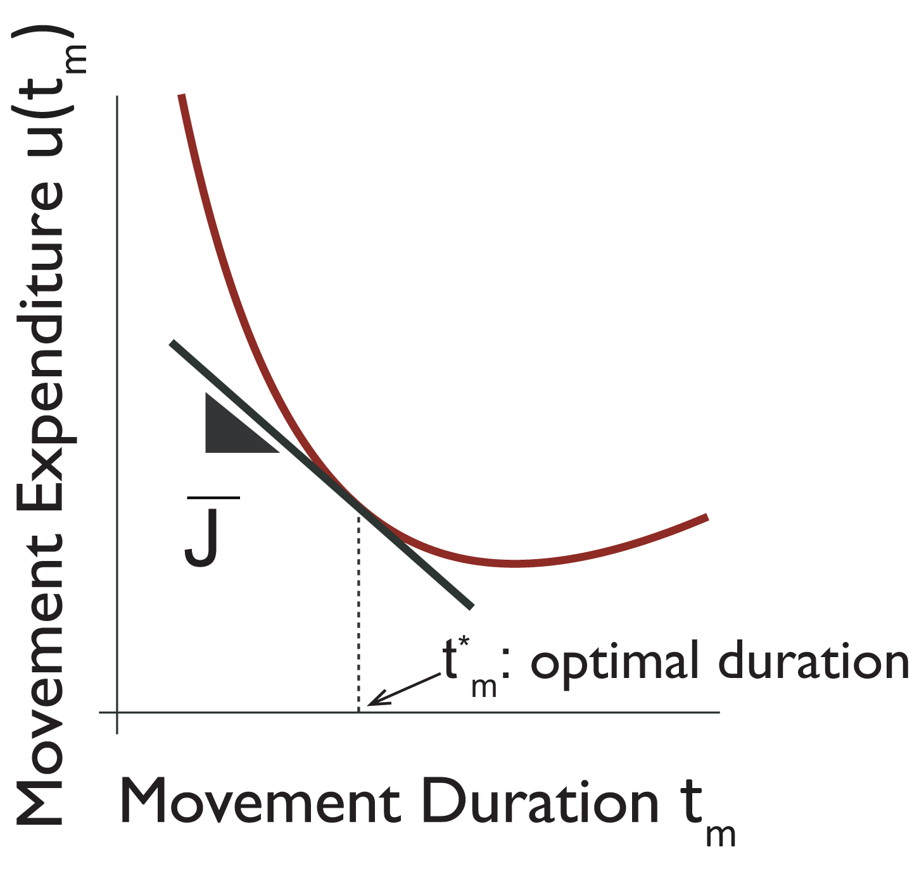
$\overline{J}$ also dictates movement vigor
Global Capture Rate:
$$\overline{J}= \frac{\sum_{n}{(f\left(t_{h}\right)−u\left(t_{m}\right))}}{\sum_{n}{(t_{h}+t_{m})}}$$
Optimal Solution:
$$\overline{J} = {\left.\frac{∂u(t_{m})}{∂t_{m}}\right|}_{t_{m}^{∗}}$$
Yoon et al, 2018
Notes:
… the corresponding duration is optimal. <highlight eqn>

Slide 33
$\overline{J}$ dictates how long to stay
Optimal Solution:
$$\overline{J} = {\left.\frac{∂f\left(t_{h}\right)}{∂t_{h}}\right|}_{t_{h}^{∗}}$$
Yoon et al, 2018
Notes:
Generalized MVT shows that jbar determines how long to stay

Slide 34
$\overline{J}$ dictates how long to stay and
Optimal Solution:
$$\overline{J} = {\left.\frac{∂f\left(t_{h}\right)}{∂t_{h}}\right|}_{t_{h}^{∗}}$$
AND
Yoon et al, 2018
Notes:
…as well as…

Slide 35
$\overline{J}$ dictates how long to stay and how fast to move to the next patch
Optimal solution:
$$\overline{J} = {\left.\frac{∂f\left(t_{h}\right)}{∂t_{h}}\right|}_{t_{h}^{∗}}$$
AND
$$\overline{J} = {\left.\frac{∂u(t_{m})}{∂t_{m}}\right|}_{t_{m}^{∗}}$$
Yoon et al, 2018
Notes:
…. How fast to move to the next patch

Slide 36
Does the quality of the environment modulate vigor of movements?
Notes:
So reminding ourselves of the research question, the theory we have considered says that
Colin;s comments : “within this framework, yes…”

Slide 37
When environment quality improves…
Notes:
We focus particularly on the predictions for vigor. What happens when, for a given movement, environment quality improves.
Colin: cost instead of expenditure for consistency

Slide 38
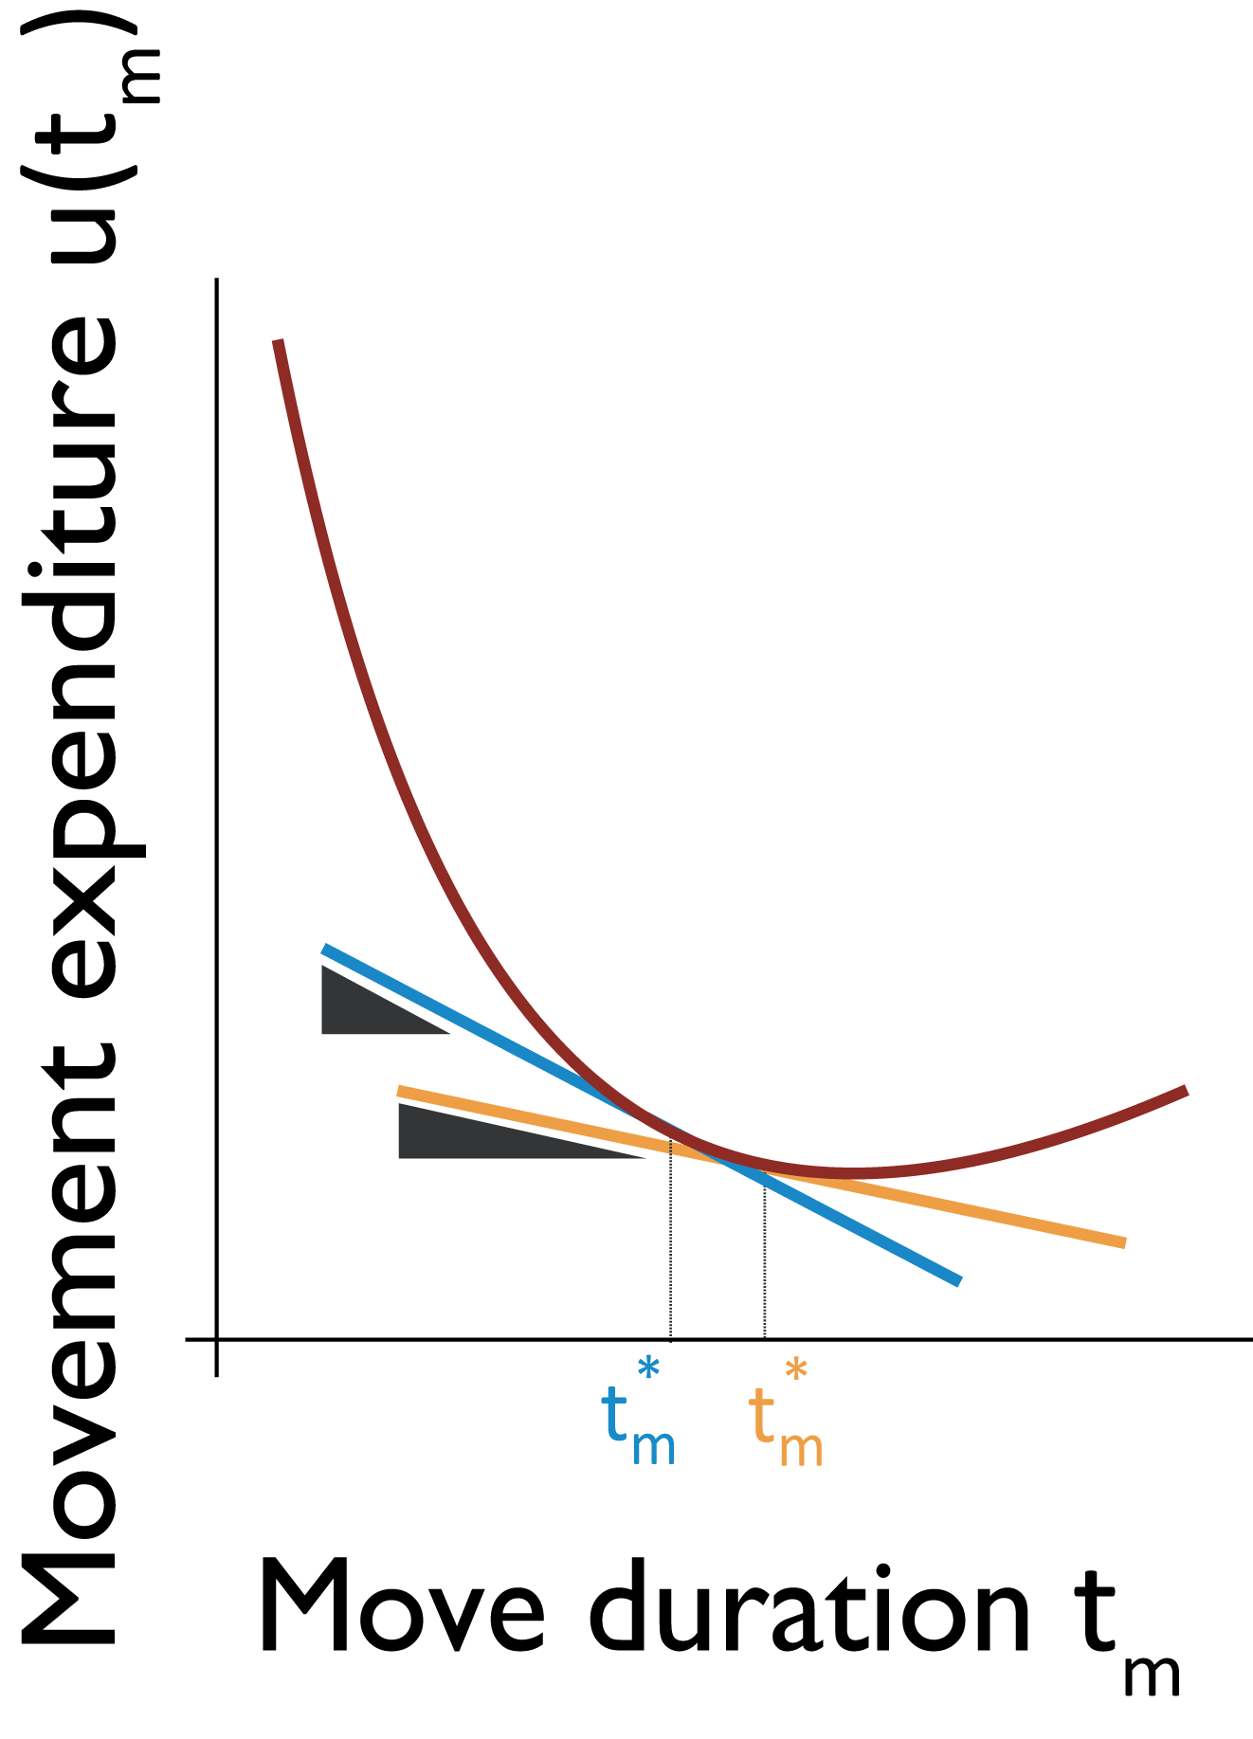
…Optimal movement duration decreases
In a better environment (higher $\overline{J}$), it is optimal to move faster.
Notes:
The theorem predicts that for a higher Jbar, the movement duration decreases, or that vigor increases.

Slide 39
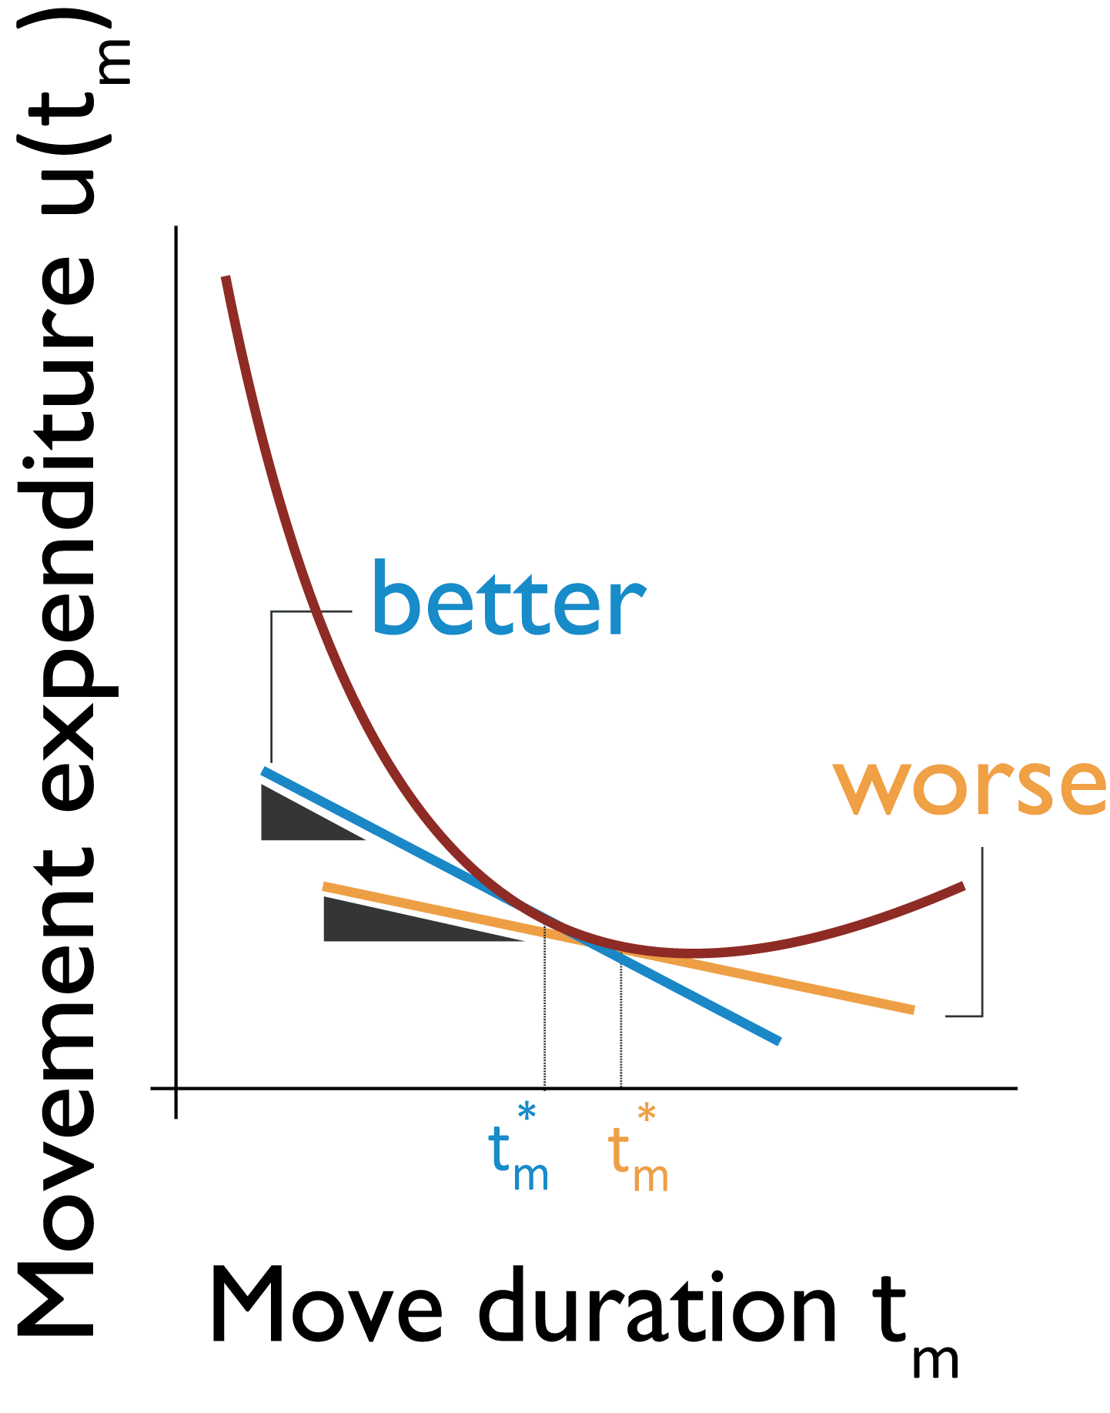
…Optimal movement duration decreases
In a better environment (higher $\overline{J}$), it is optimal to move faster.
Notes:
The theorem predicts that for a higher Jbar, the movement duration decreases, or that vigor increases.

Slide 40
…Optimal movement duration decreases
In a better environment (higher $\overline{J}$), it is optimal to move faster.
Here, we consider the effect of effort on environment capture rate.
Notes:
Specifically, in our study, we focus on the effect of changing movement effort on global capture rate. Slow the better environment in blue …<move to next slide>
Highlight better and worse first before going to low and high effort

Slide 41
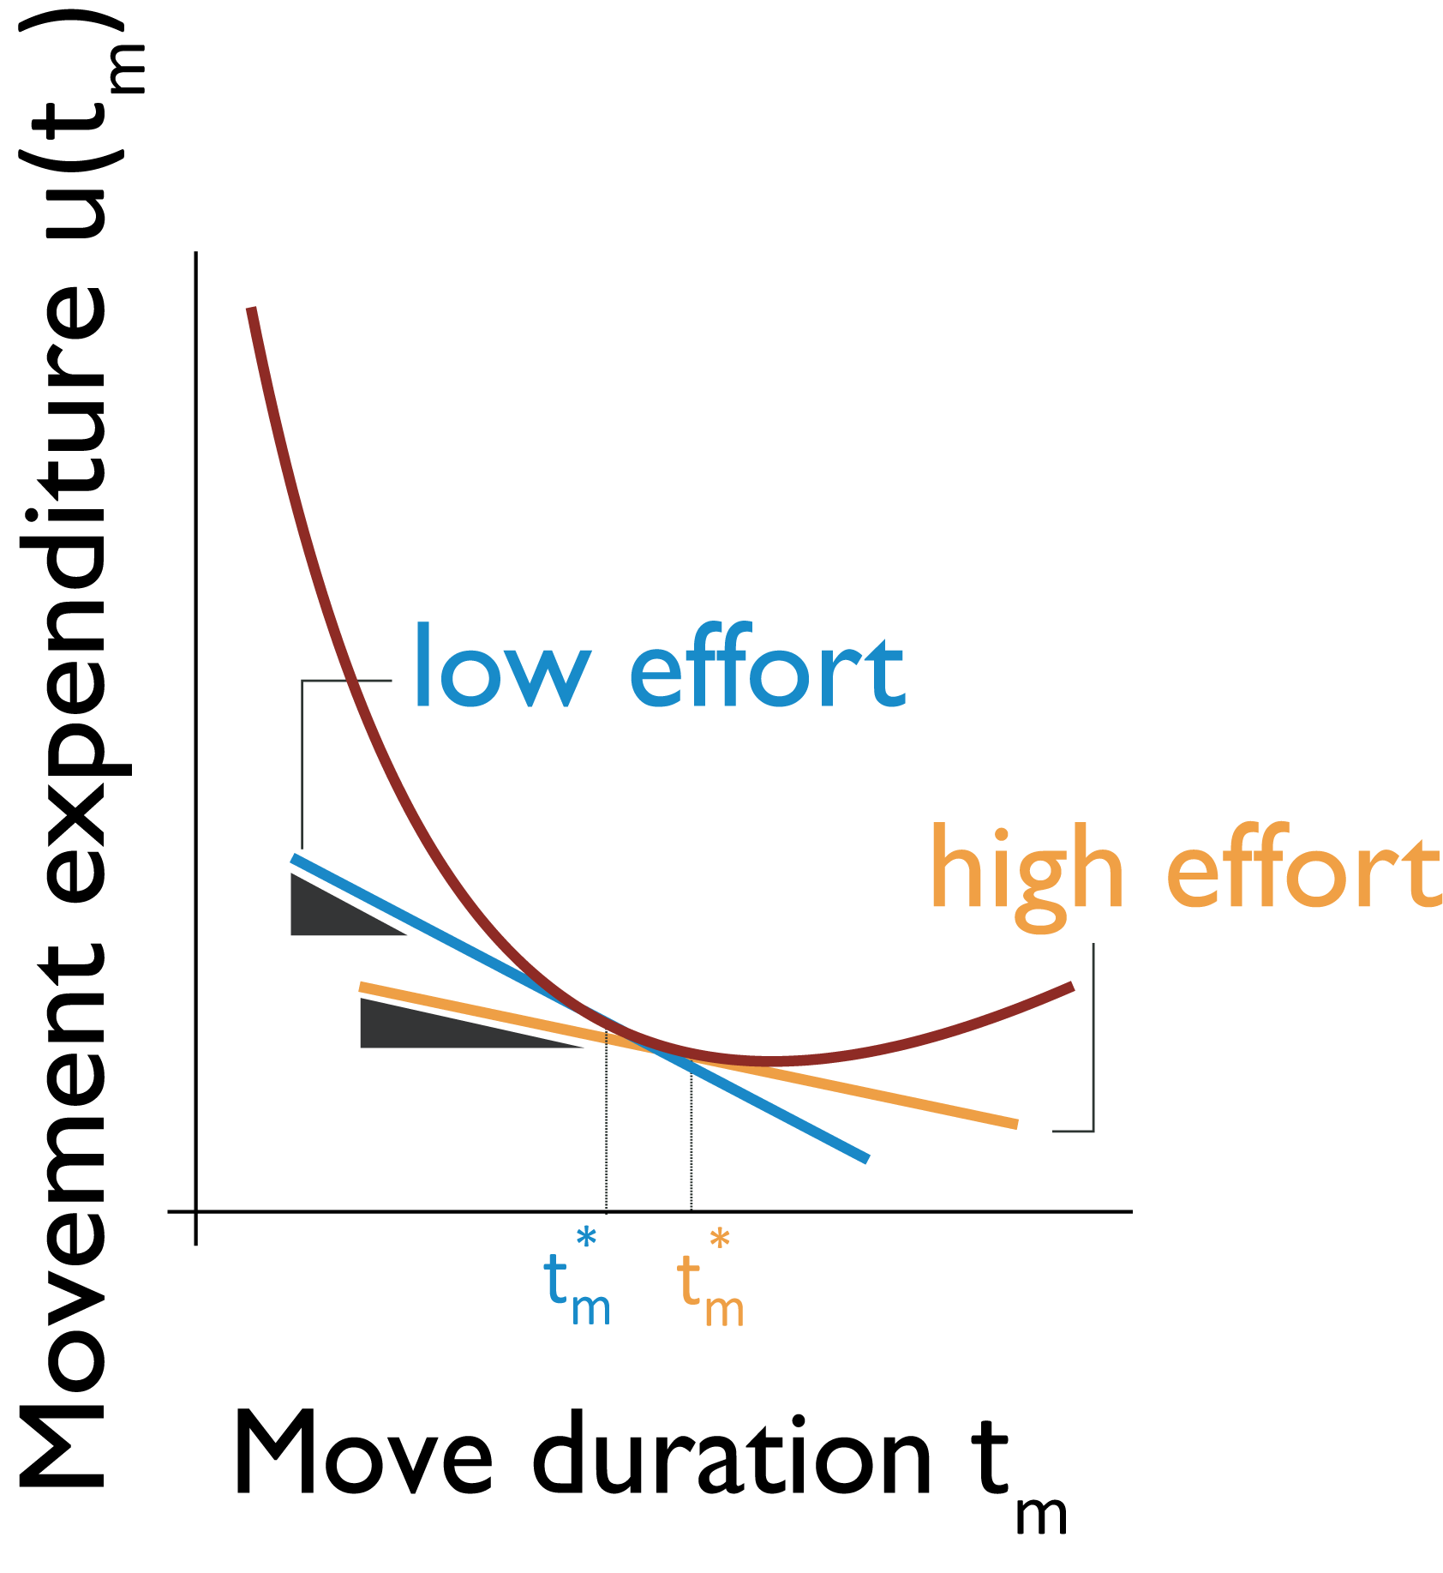
…Optimal movement duration decreases
In a better environment (higher $\overline{J}$), it is optimal to move faster.
Here, we consider the effect of effort on environment capture rate.
In the low effort environment, movement vigor is higher than in the high effort environment.
Notes:
… would refer to a low effort environment as compared to the one highlighted in yellow- the high effort env

Slide 42
H1: Vigor increases after history of low effort
In a better environment (higher $\overline{J}$), it is optimal to move faster.
Here, we consider the effect of effort on environment capture rate.
In the low effort environment, movement vigor is higher than in the high effort environment.
Notes:
Therefore, we have our first Hypothesis <say it>

Slide 43
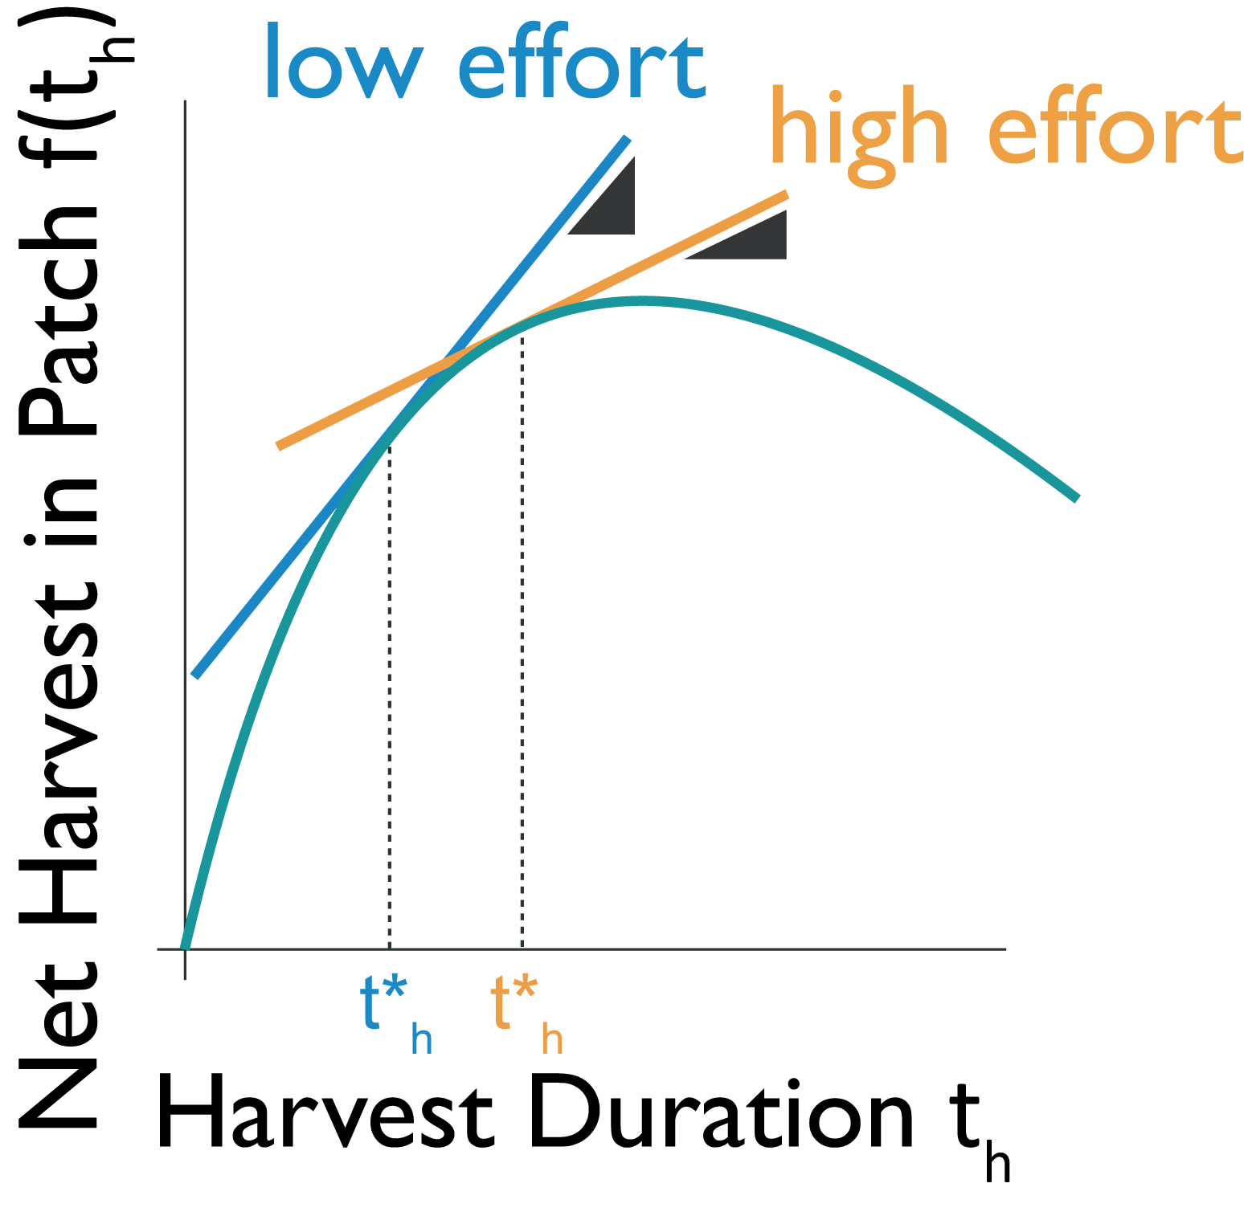
H2: Harvest duration decreases after history of low effort
In a better environment (higher $\overline{J}$), it is optimal to leave a patch sooner.
Global capture rate of the environment is modulated by changing effort.
In the low effort environment, harvest duration is lower than in the high effort environment.
Notes:
Similarly, we have a hypothesis for harvest behaviour in the patch that follows from both the classical MVT. Here again we’re looking at the change in harvest duration due to environment effort changes.
Slow down here

Slide 44
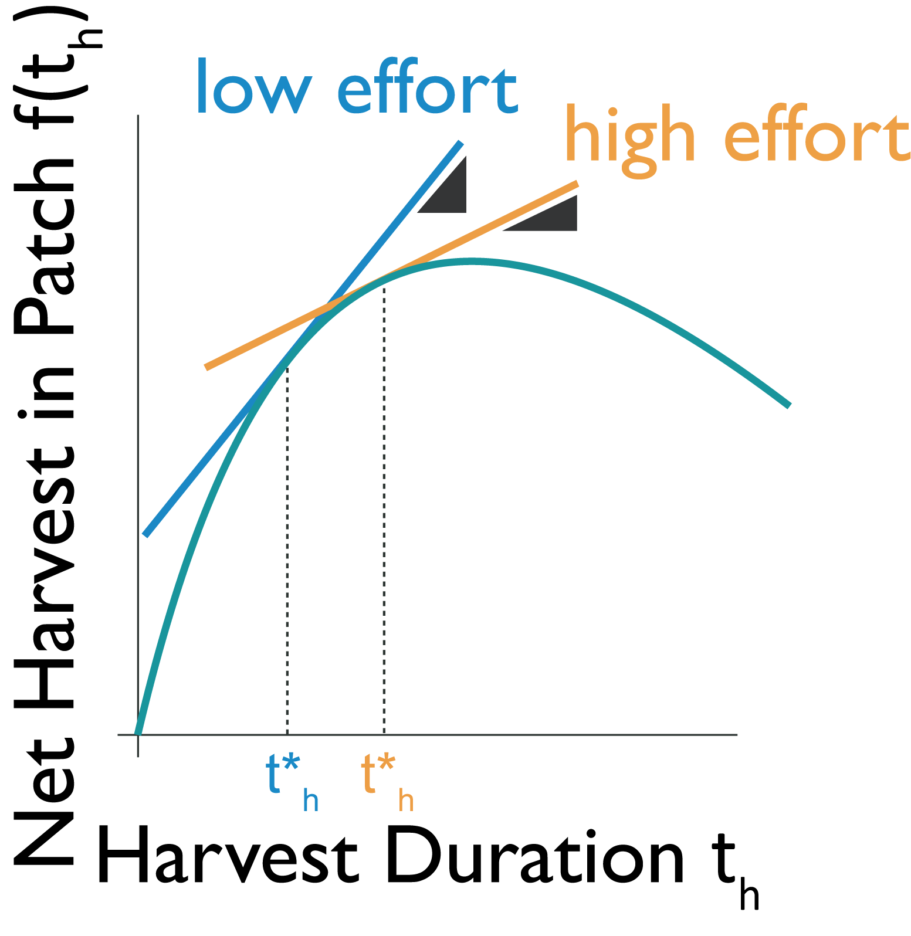
Hypotheses
H1. Movement vigor between patches increases after a history of low effort as compared to a history of high effort.
H2. Duration of harvest decreases after a history of low effort as opposed to a history of high effort.
Movement vigor
Harvest behavior
Notes:
<reiterate; emphasize on effort; Remind people of apples >
Gary: maybe use pictures instead of long sentences
Rachel: if reading out use pictures

Slide 45
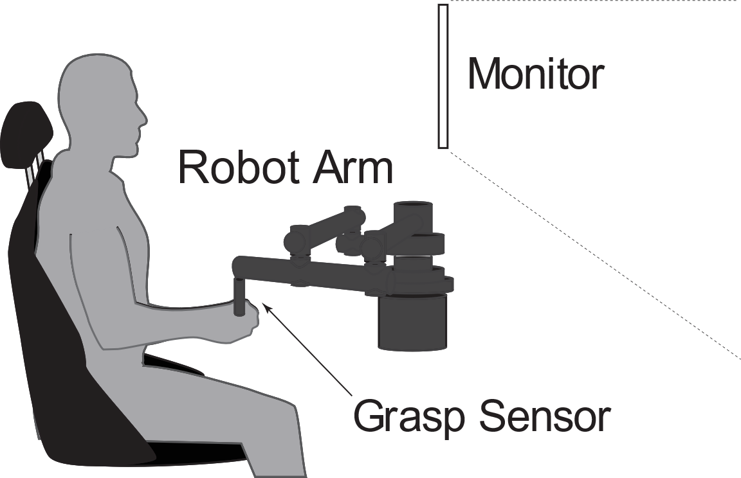
Experimental Setup
Subjects (N=20) aged between 21-32 years were recruited.
Notes:
Subjects were recruited to make planar horizontal seated arm reaching task that emulated patch foraging. We recruited 20 but 2 were excluded as they were unable to complete the experiment within reasonable time.

Slide 46
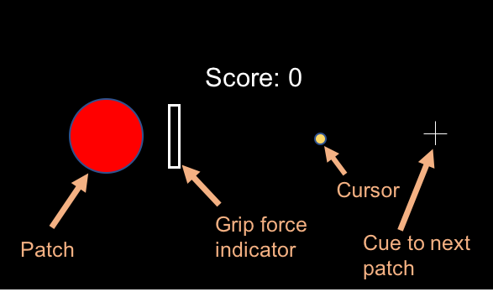
Arm Reaching Foraging Task
Notes:
Subjects saw a game screen on which they controlled a cursor with their reaches.

Slide 47
Subjects reached to rewarded patches
Notes:
< next few slides will be paraphrases and expansions on the titles >

Slide 48
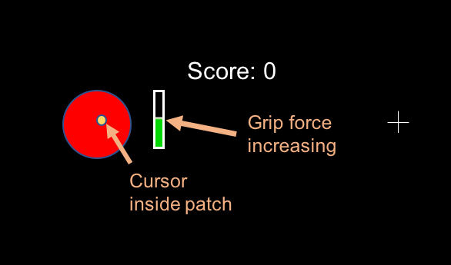
Reward was dispensed at decaying rate…

Slide 49
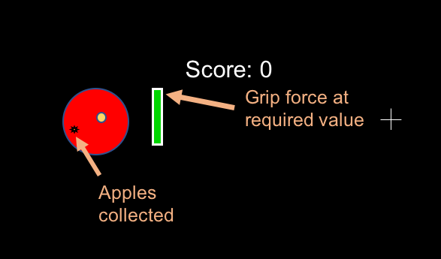
… while required force was maintained
Notes:
Note to self :
Need to change apples to berries here

Slide 50
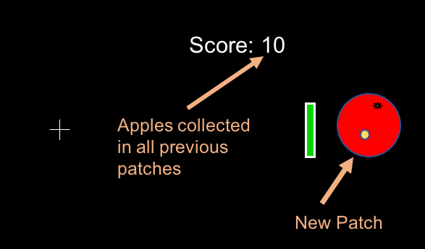
Subjects were free to move on at any time

Slide 51
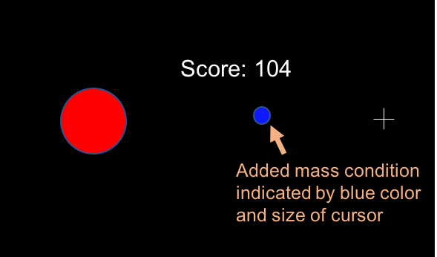
Added mass was used to modulate effort
Notes:
As we said before, we want to look at the change in vigor and other behaviour due to overall effort which was modulated by adding mass to the reach. Added mass was simulated by means of acceleration dependent resistive forces.
So how much mass was added.

Slide 52
Protocol
Subjects performed reach-and-harvest trials in two different environments in counterbalanced order.
Notes:
< protocol slides will paraphrase text on slide and add info with added graphics>

Slide 53
Protocol
Subjects performed reach-and-harvest trials in two different environments in counterbalanced order.

Slide 54
Protocol
Subjects performed reach-and-harvest trials in two different environments in counterbalanced order.

Slide 55
Protocol
Subjects performed reach-and-harvest trials in two different environments in counterbalanced order.

Slide 56
Protocol
Subjects performed reach-and-harvest trials in two different environments in counterbalanced order.
Notes:
Probe trial txt in purple hard to read – change txt color to be dark purple

Slide 57
Metrics of Reach Vigor
Notes:
We quantified vigor of movement between patches through two metrics.

Slide 58
Metrics of Reach Vigor
Peak Velocity (m/s)
Notes:
Peak velocity of the reach and travel duration

Slide 59
Metrics of Reach Vigor
Peak Velocity (m/s)
Travel Duration (s)
Notes:
and travel duration

Slide 60
Probe trials reflect effect of environment
Metrics of vigor are compared between probe trials that have equivalent mass (m=2kg)
Notes:
Our main concern is the effect of global capture rate on vigor of movements. To determine whether this effect exists, we compare the vigor of probe trials between the two environments. This comparison is interesting as the immediate added mass to these trials remains the same (2kg). So any modulation is likely due to the history of effort.

Slide 61
Probe trials reflect effect of environment
Peak velocity is compared between probe trials that have equivalent mass (m=2kg)
Notes:
We compare peak velocity between the two environments

Slide 62
Probe trials reflect effect of environment
Travel duration is compared between probe trials that have equivalent mass (m=2kg)
Notes:
… as well as travel duration

Slide 63
Vigor increases after history of low effort
Notes:
We start by comparing PV between the two environments

Slide 64
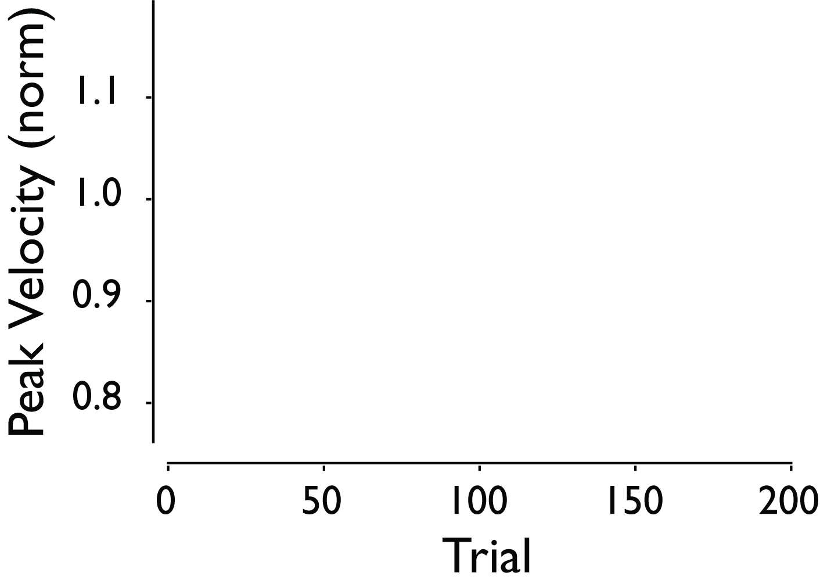
Vigor increases after history of low effort
Notes:
We plot peak velocity in each environment (y axis) with respect to trial number (x axis)

Slide 65
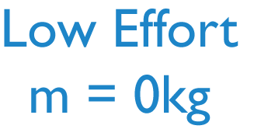
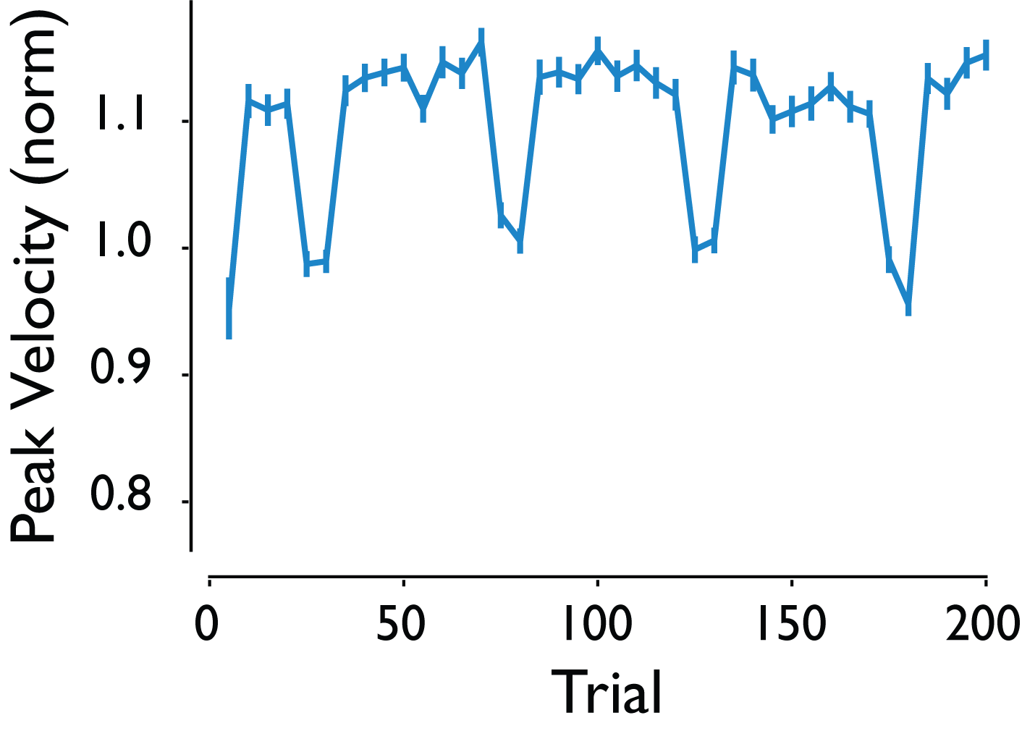
Vigor increases after history of low effort
Notes:
Here is the behaviour in the low effort environment

Slide 66
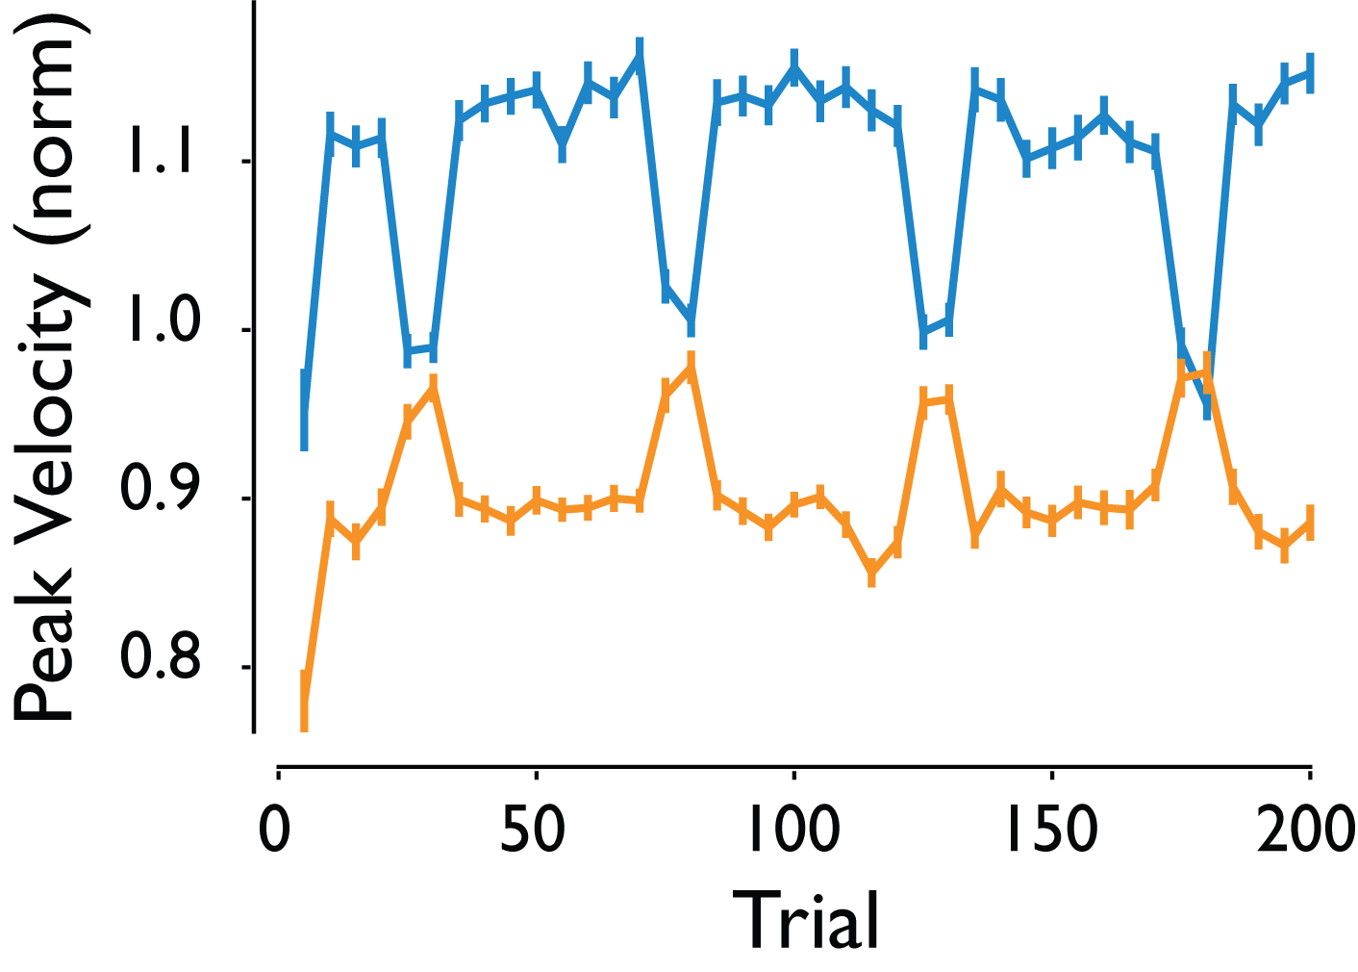
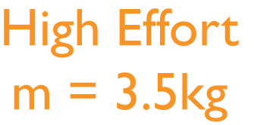
Vigor increases after history of low effort
Notes:
Compare that to pv in the high effort environment.
In words/text say low and high effort (add the words low and high effort)

Slide 67
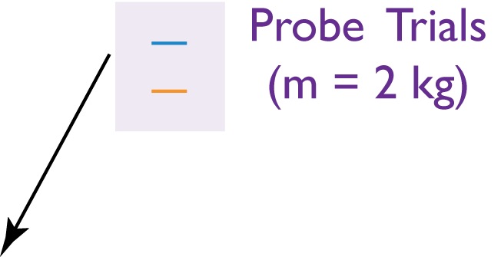
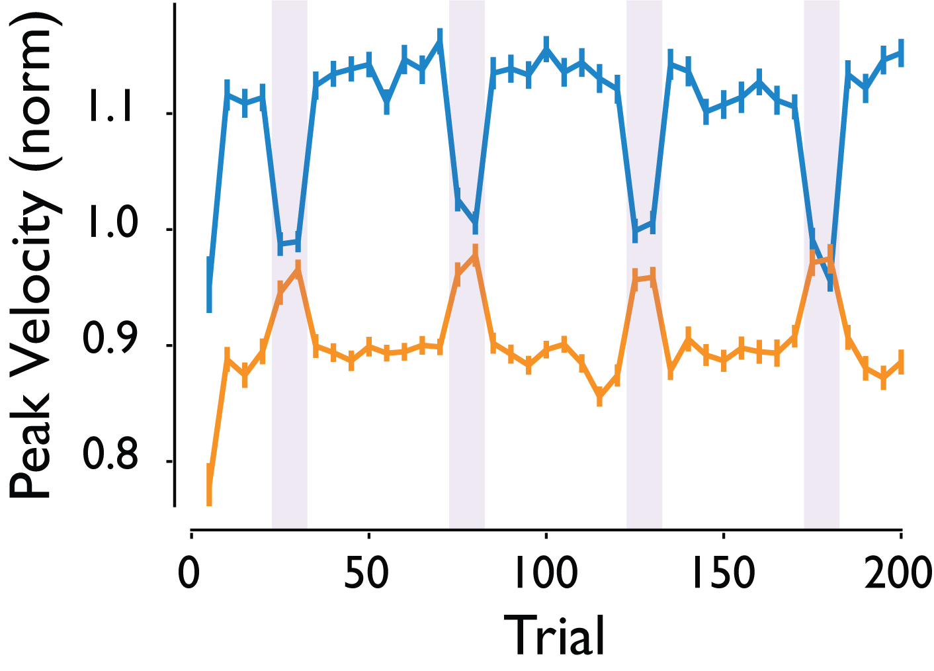
Vigor increases after history of low effort
Notes:
Looking at probe trials , we see first that within environment there is an effect of immediate mass on PV. Subjects sense the change in mass and modulate vigor accordingly. Focusing on the probe trials alone, we additionally see that despite the effect of immediate mass , probe trials in the low effort environment may on average be faster

Slide 68
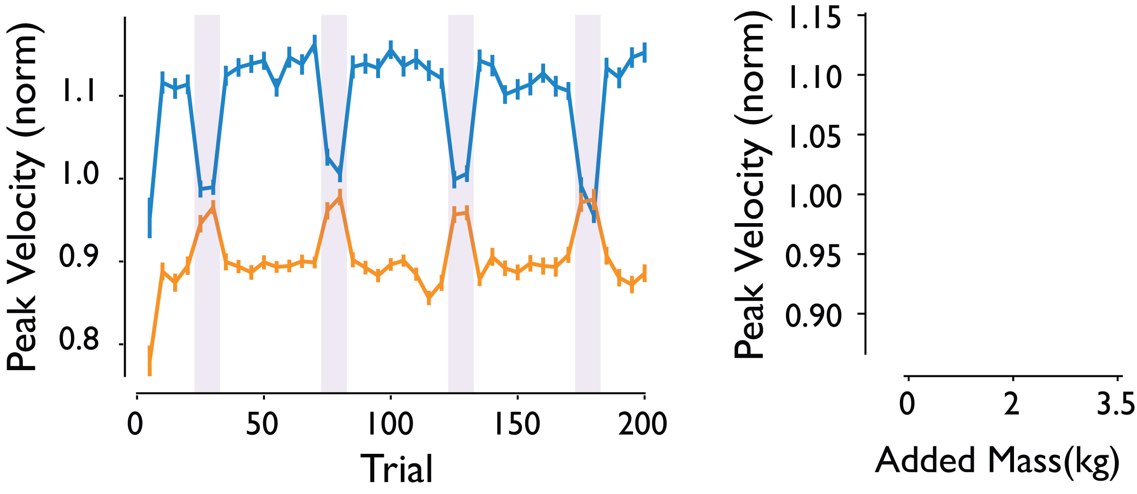
Vigor increases after history of low effort
Notes:
Looking at the change with respect to mass overall.

Slide 69
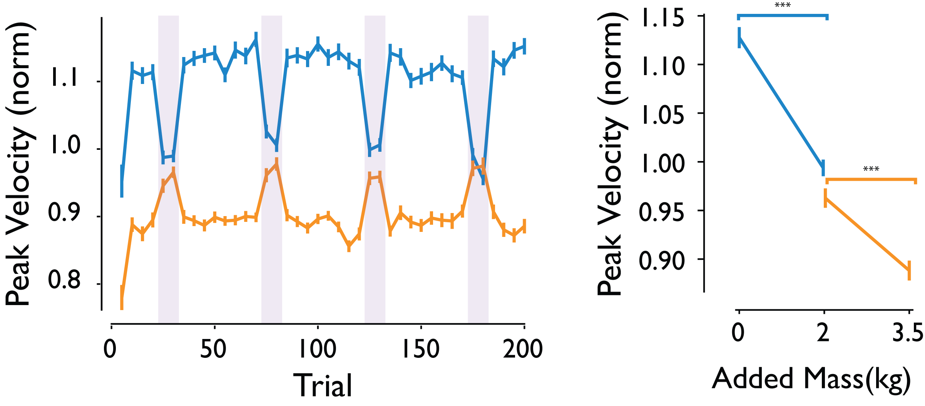
Vigor increases after history of low effort
Notes:
We see exactly the same trends within env

Slide 70
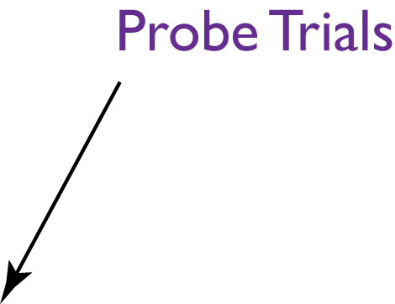
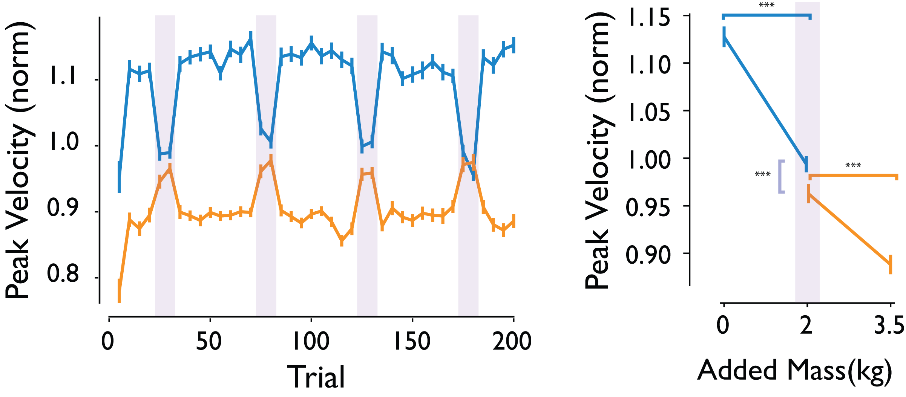
Vigor increases after history of low effort
Notes:
But critically, we see that in those probe trials, changes happen with respect to environment effort.

Slide 71
Vigor increases after history of low effort
Notes:
Visualizing travel duration effects with respect to mass

Slide 72
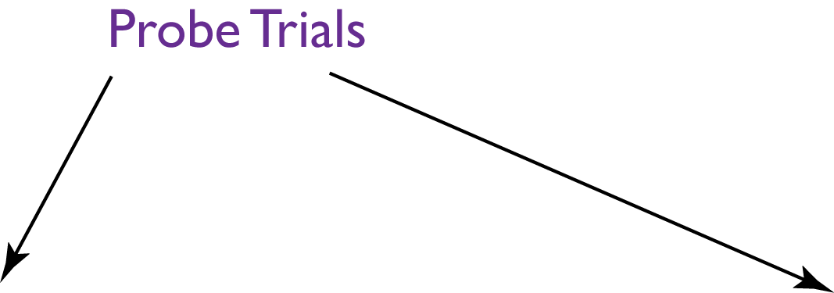
Vigor increases after history of low effort
Notes:
We find very similar behaviour. Subjects not only slow down with added immediate mass, but with change in environment effort, they accordingly modulate their peak velocity as well as travel duration.
Add text : subjects modulated vigor according to effort on current trials and also due to history of effort.

Slide 73
Vigor increases after history of low effort
Subjects modulated their vigor in response to both immediate and history of effort
Notes:
We find very similar behaviour. Subjects not only slow down with added immediate mass, but with change in environment effort, they accordingly modulate their peak velocity as well as travel duration.
Add text : subjects modulated vigor according to effort on current trials and also due to history of effort.
Gary : make the text below as white on black

Slide 74
Hypotheses
H1. Movement vigor between patches increases after a history of low effort as compared to a history of high effort.
H2. Duration of harvest decreases after a history of low effort as opposed to a history of high effort.
Movement vigor
Harvest behavior

Slide 75
Hypotheses
H1. Movement vigor between patches increases after a history of low effort as compared to a history of high effort.
H2. Duration of harvest decreases after a history of low effort as opposed to a history of high effort.
Movement vigor
Harvest behavior
Notes:
So when it comes to movement vigor, we find that after a history of low effort subjects do increase their vigor
Despite identical immediate effort requirements .

Slide 76
Hypotheses
H1. Movement vigor between patches increases after a history of low effort as compared to a history of high effort.
H2. Duration of harvest decreases after a history of low effort as opposed to a history of high effort.
Movement vigor
Harvest behavior
Notes:
We now look at the effect of environment effort on harvest behavior.
Gary: disconnect between the harvest duration and what ramp up and giving up ; change the wording to reflect patch residency

Slide 77
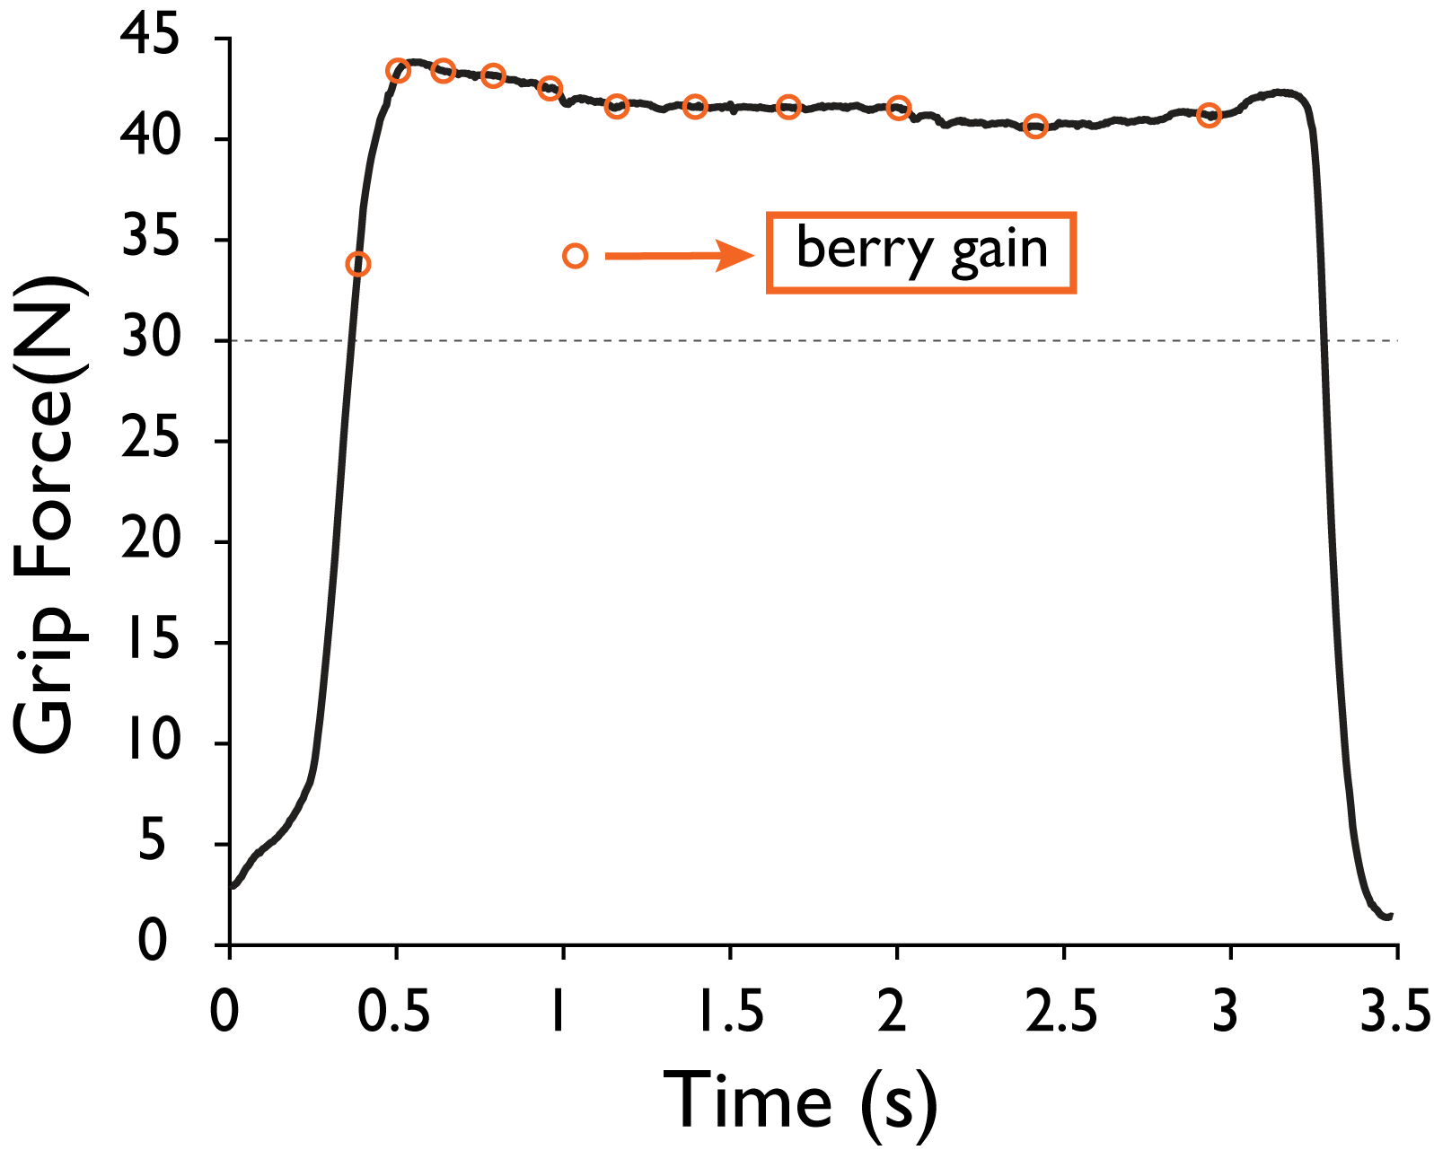
Effect of environment effort on berry count
Subjects collect berries at decaying rate when their force is maintained above 30N.
Notes:
First, we considered whether the absolute number of berries harvested changed due to environment effort.
At the absolute berry count level, we expect subjects to collect more berries per patch in the high effort env. Remember, subjects need to maintain force at 30 N < point to fig>

Slide 78
Berry count was unaffected by environment effort
There was no significant difference between environments in number of berries collected (p=0.69).
Notes:
We found that there was no significant effect of environment effect on count of berries.

Slide 79
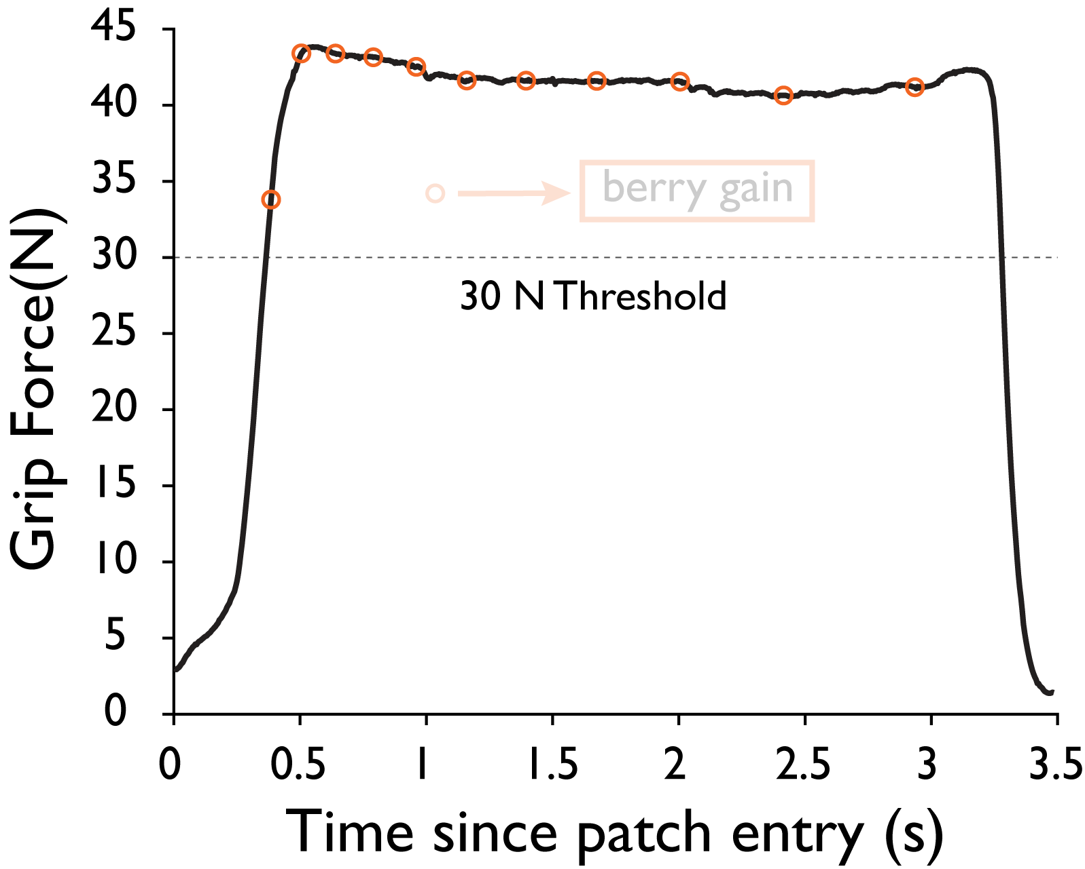
Behavior upon patch entry
Subjects collect berries at decaying rate when their force is maintained above 30N.
Notes:
We decided to zoom out and consider what entails harvesting of rewards by subjects

Slide 80
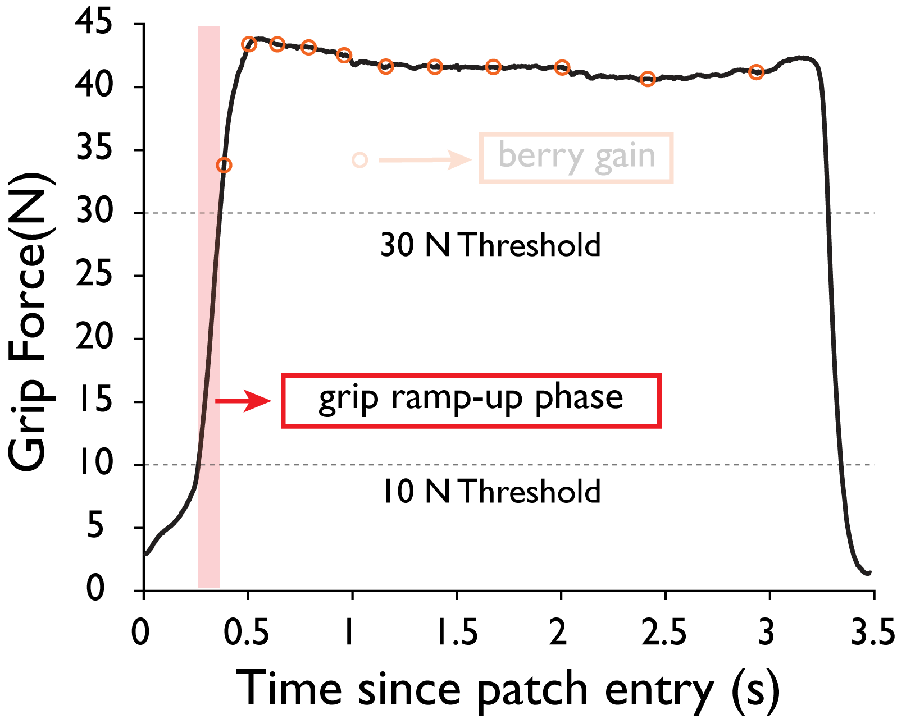
Behavior upon patch entry
Subjects collect berries at decaying rate when their force is maintained above 30N.
Does environment effort affect their ramp-up behavior?
Notes:
<bring in ramp up phase>
How quickly do you begin to harvest reward?

Slide 81
Grip Ramp-up Metrics
Notes:
We use two metrics to quantify ramp up behaviour <>

Slide 82
Grip Ramp-up Metrics
Peak Force Rate (N/s)
Notes:
We use two metrics to quantify ramp up behaviour <>

Slide 83
Grip Ramp-up Metrics
Peak Force Rate (N/s)
Grip Ramp-up Duration(s)
Notes:
We use two metrics to quantify ramp up behaviour <>

Slide 84
Probe trials reflect effect of environment
Metrics of harvest behavior are compared between probe trials that have equivalent mass (m=2kg)
Notes:
Once again, we look at the effect of environment effort by focusing on those probe trials.

Slide 85
Probe trials reflect effect of environment
Peak force rate and grip ramp-up duration are compared between probe trials that have equivalent mass (m=2kg)
Notes:
For both peak force rate and well as ramp up duration.

Slide 86
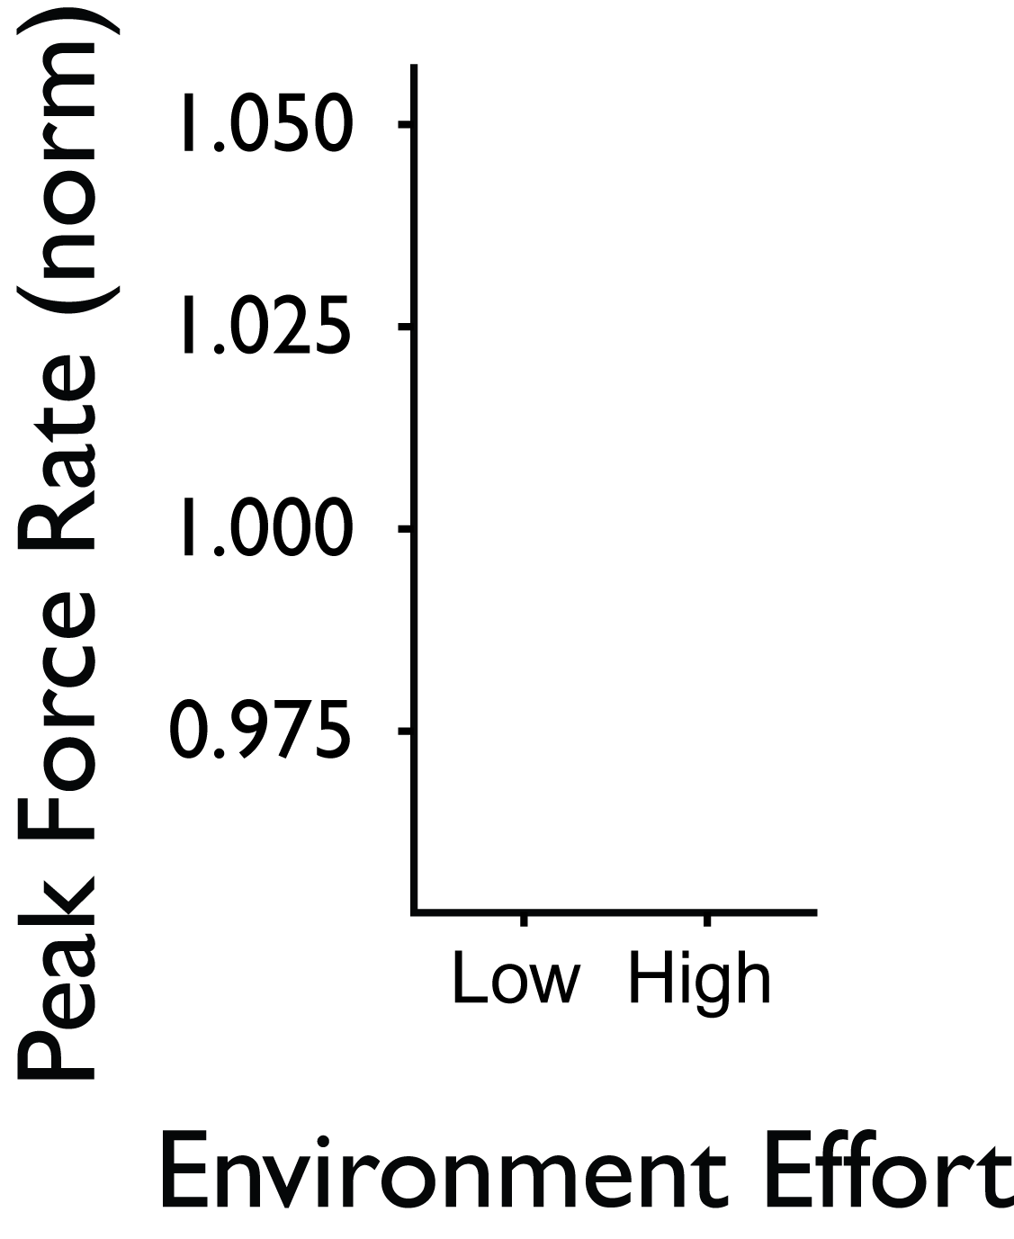
Grip ramp-up is faster after history of low effort
Peak Force Rate (N/s):
Notes:
Note to Alaa: I did not add the profiles here since I haven’t added profiles for vigor (moved to backup section) to maintain symmetry,

Slide 87
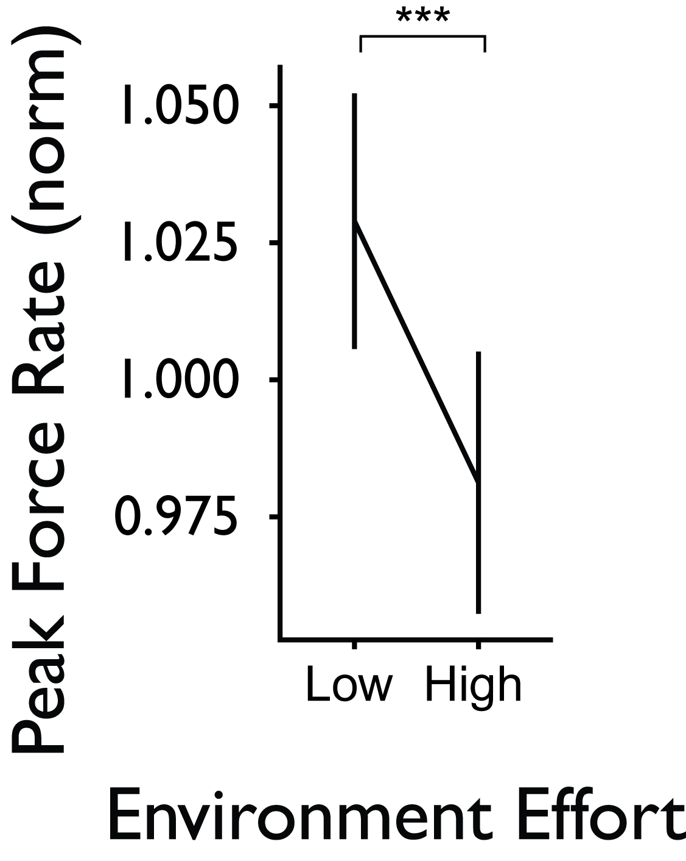
Grip ramp-up is faster after history of low effort
Peak Force Rate (N/s):
Subjects increase the rate of grip ramp-up in the low effort environment (p<0.001).
Notes:
Do the same thing with metrics and protocol figure to show that you’re comparing between probe trials

Slide 88
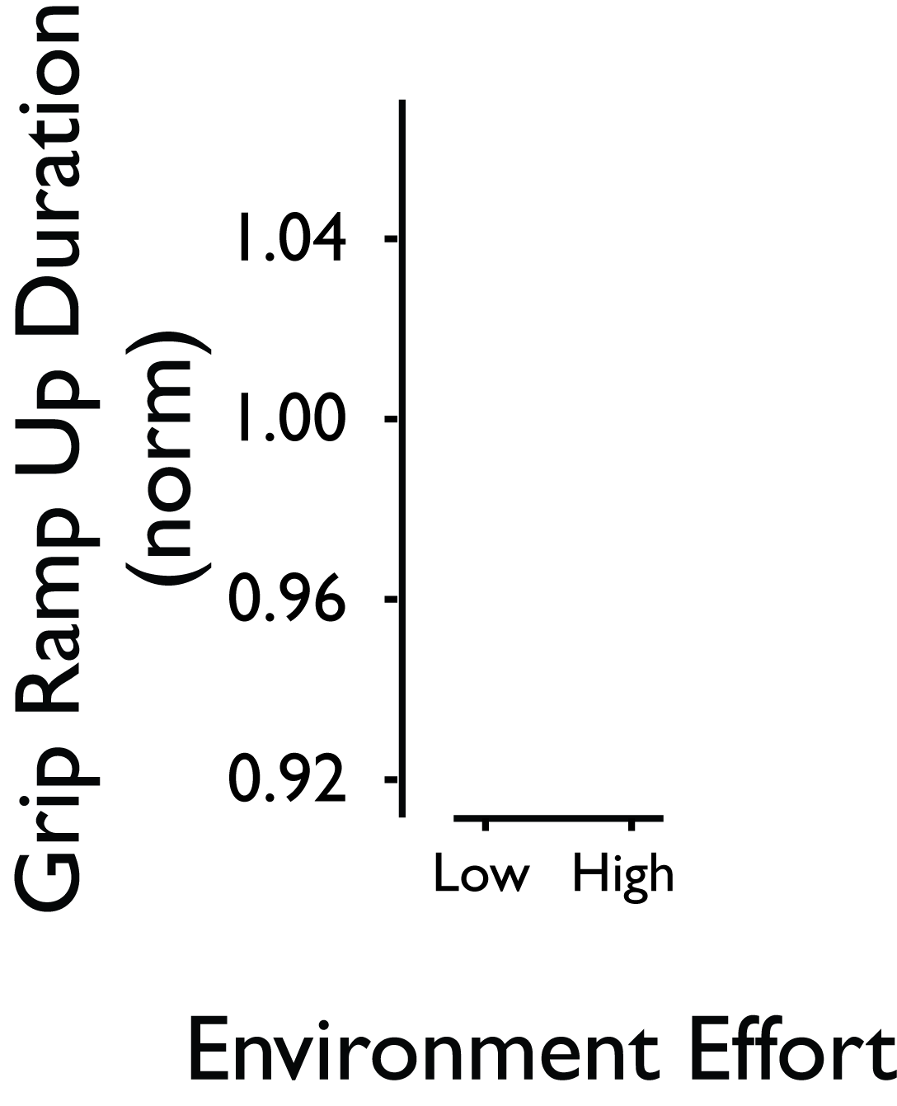
Grip ramp-up is faster after history of low effort
Grip Ramp-up Duration (s):

Slide 89
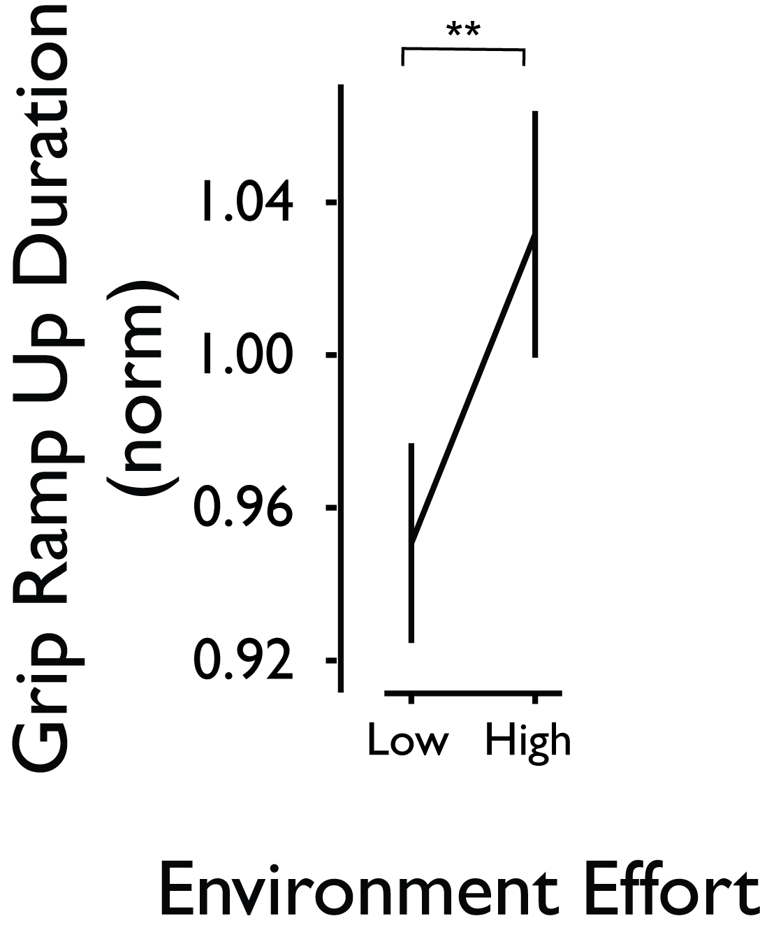
Grip ramp-up is faster after history of low effort
Grip Ramp-up Duration (s):
Subjects take less time to increase their force to the threshold in the low effort environment (p=0.002).

Slide 90
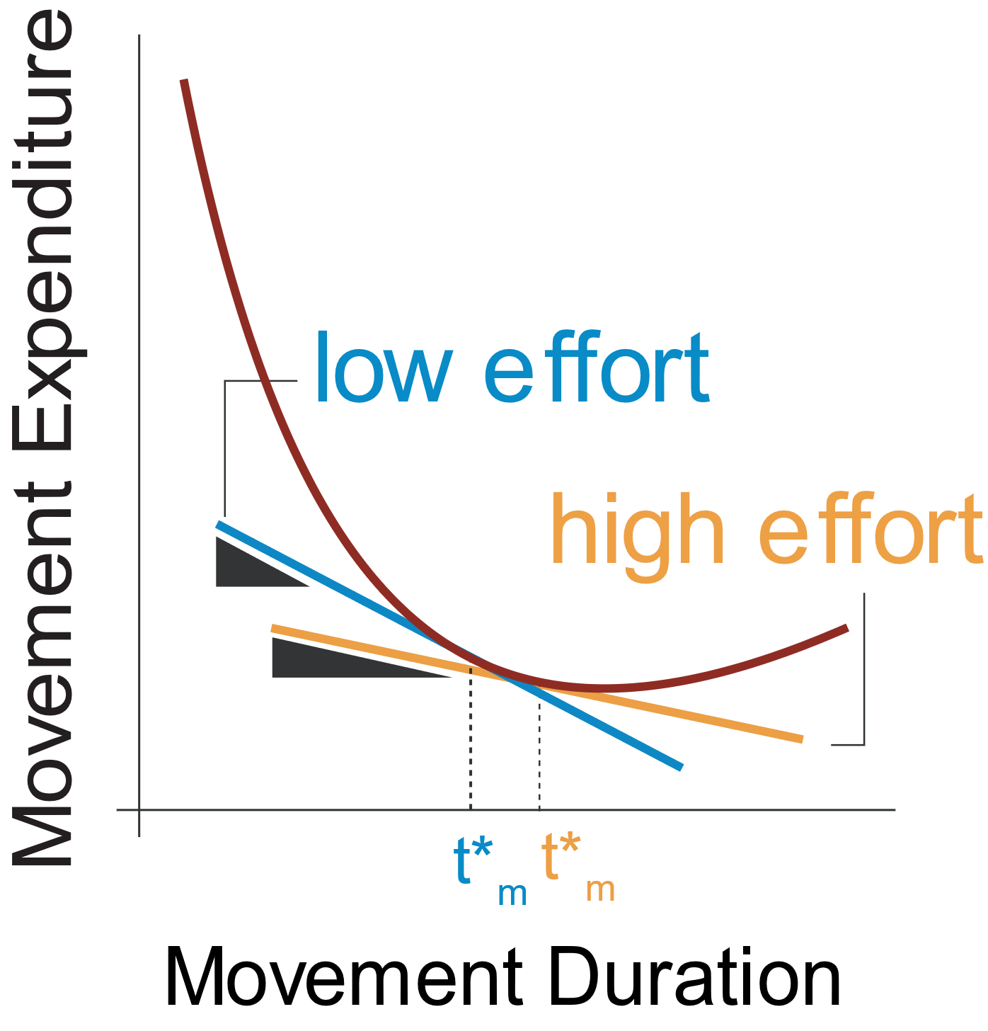
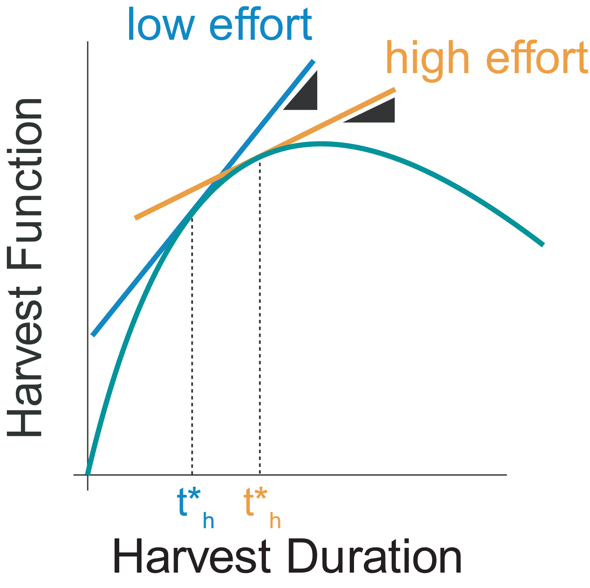
Hypotheses
H1. Movement vigor between patches increases after a history of low effort as compared to a history of high effort.
H2. Duration of harvest decreases after a history of low effort as opposed to a history of high effort.
Movement vigor
Harvest behavior
Notes:
Thinking back to our hypothesis- even though we did not the an effect on the absolute berry count, we did find that environment effort expenditure modulated other decisions subjects made while harvesting within a patch.

Slide 91
Hypotheses
H1. Movement vigor between patches increases after a history of low effort as compared to a history of high effort.
H2. Duration of harvest decreases after a history of low effort as opposed to a history of high effort.
Movement vigor
Harvest behavior
Notes:
Subjects decreased their grip ramp up time as well as their giving-up time in the low effort environment.

Slide 92
Summary
H1. Movement vigor between patches increases after a history of low effort as compared to a history of high effort.
H2. Duration of harvest decreases after a history of low effort as opposed to a history of high effort.
Movement vigor
Harvest behavior
Notes:
In summary, we find that global effort expenditure impacts not just movement vigor, but also decisions relating to gaining reward.

Slide 93
Apple-picking in an orchard
Charnov 1976; Krebs, Ryan & Charnov 1974; Hayden, Pearson & Platt 2011; Constantino & Daw 2015
Notes:
Imagine yourselves picking apples in an orchard. It’s a good orchard where it’s relatively easy to pick those apples. So, how long do you stay at one tree before moving on to the next. This type of stay or switch decision has been explored in length in ecology, computational psychology and neuroscience.
But let us think about another question: after you decide you’re done with a tree, how fast do you move to the next tree?
Citations of previous foraging literature.

Slide 94
Limitations and future work
$$\overline{J}= \frac{\sum_{n}{(f\left(t_{h}\right)−u\left(t_{m}\right))}}{\sum_{n}{(t_{h}+t_{m})}}$$
Do changes in $\overline{J}$ through $f\left(t_{h}\right)$ modulate vigor of current movement?
How is $\overline{J}$ learnt in a dynamic or novel environment? How does vigor change in response?
Notes:
<run through it quickly>
How are other ways to modulate global rate?
How is Jbar updated?

Slide 95
Conclusion
Global capture rate is modulated by movement effort.
$$\overline{J}= \frac{\sum_{n}{(f\left(t_{h}\right)−u\left(t_{m}\right))}}{\sum_{n}{(t_{h}+t_{m})}}$$
Notes:
In conclusion, I would like to highlight some of the contributions of this work.
First of all, we developed an experimental paradigm in which global capture rate (otherwise known as background rate of reward) is modulated through effort costs, particularly movement effort costs.
Alaa:
Bring in global capture rate

Slide 96
Conclusion
Global capture rate is modulated by movement effort.
$$\overline{J}= \frac{\sum_{n}{(f\left(t_{h}\right)−u\left(t_{m}\right))}}{\sum_{n}{(t_{h}+t_{m})}}$$
Reach vigor is modulated by changes in immediate as well as global effort expenditure.
Notes:
In conclusion, I would like to highlight some of the contributions of this work.
First of all, we developed an experimental paradigm in which global capture rate (otherwise known as background rate of reward) is modulated through effort costs, particularly movement effort costs.
Alaa:
Bring in global capture rate

Slide 97
Conclusion
Global capture rate is modulated by movement effort.
$$\overline{J}= \frac{\sum_{n}{(f\left(t_{h}\right)−u\left(t_{m}\right))}}{\sum_{n}{(t_{h}+t_{m})}}$$
Reach vigor is modulated by changes in immediate as well as global effort expenditure.
Unified framework that explains both movement vigor and harvest decisions are modulated by changing global effort.
Notes:
In conclusion, I would like to highlight some of the contributions of this work.
First of all, we developed an experimental paradigm in which global capture rate (otherwise known as background rate of reward) is modulated through effort costs, particularly movement effort costs.
Alaa:
Bring in global capture rate

Slide 98
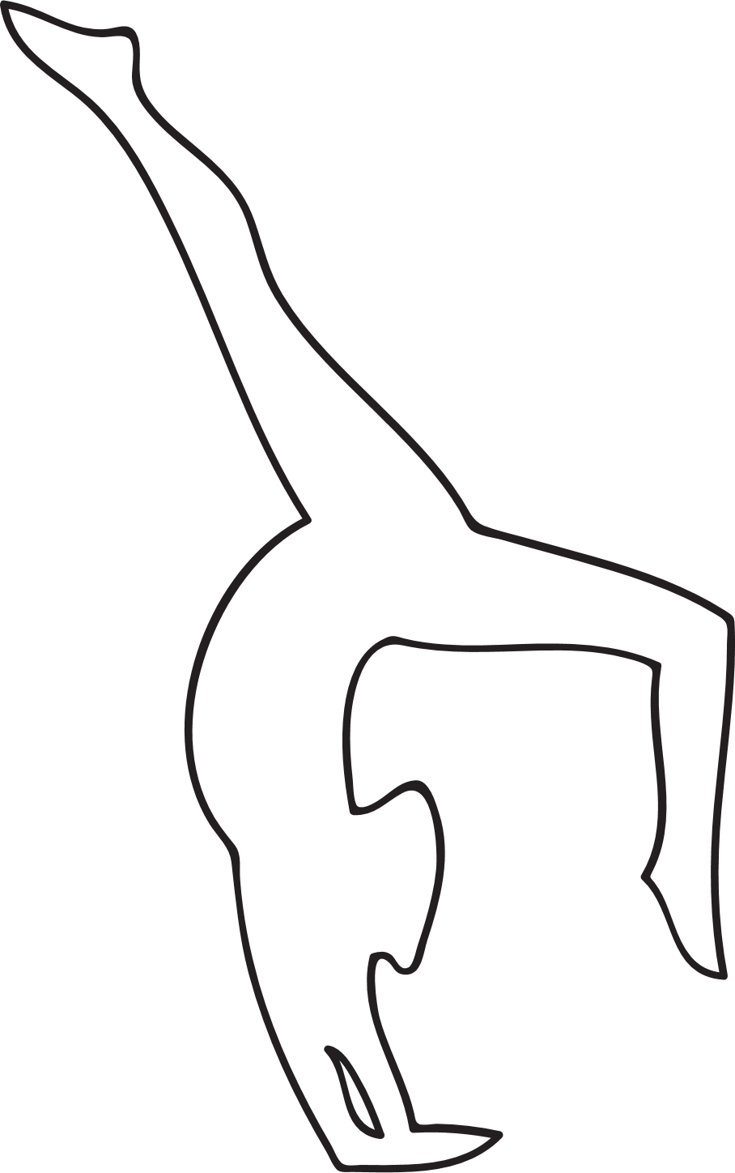
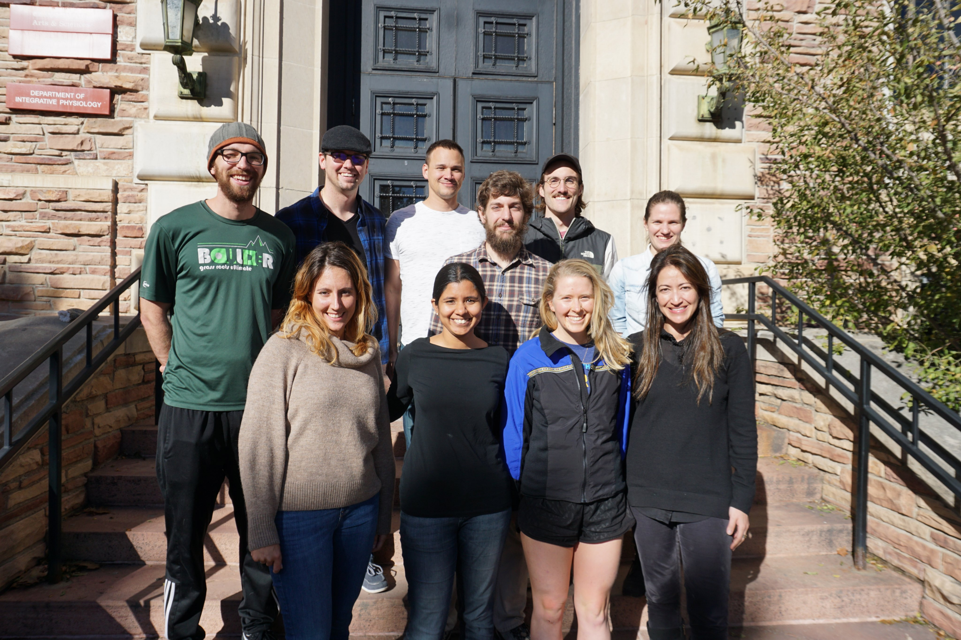
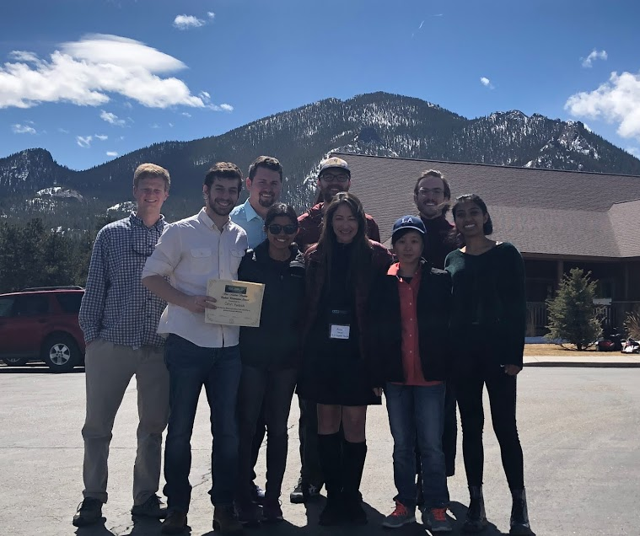
Thank You
Award: NINDS R01NS096083
Notes:
I’d like to thank labmates for community and support – especially during these times.
We’d like to thank our NIH funding

Slide 99
Questions

Slide 101
Backup Slides

Slide 102
Harvest Function

Slide 103
Net Harvest in Patch

Slide 104
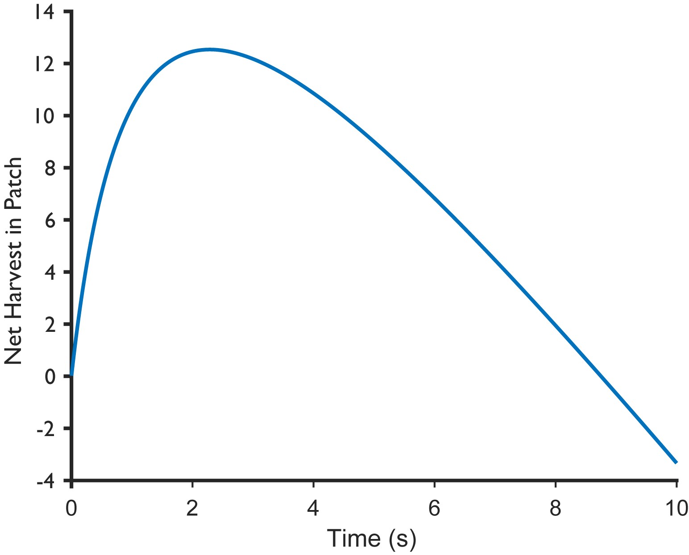
Net Harvest in Patch

Slide 105
Additional Vigor Results
Inter-individual differences

Slide 106
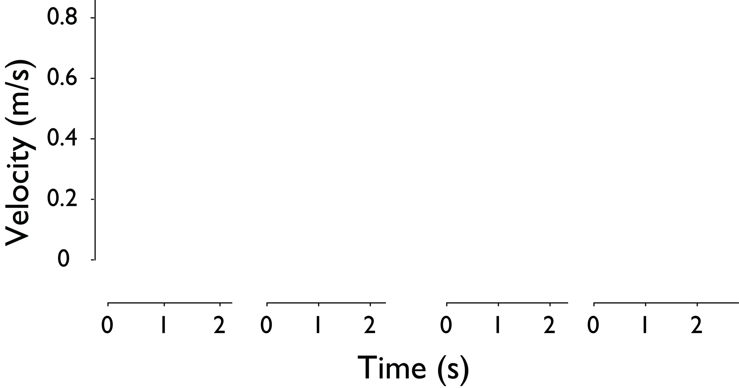
Velocity Profile

Slide 107
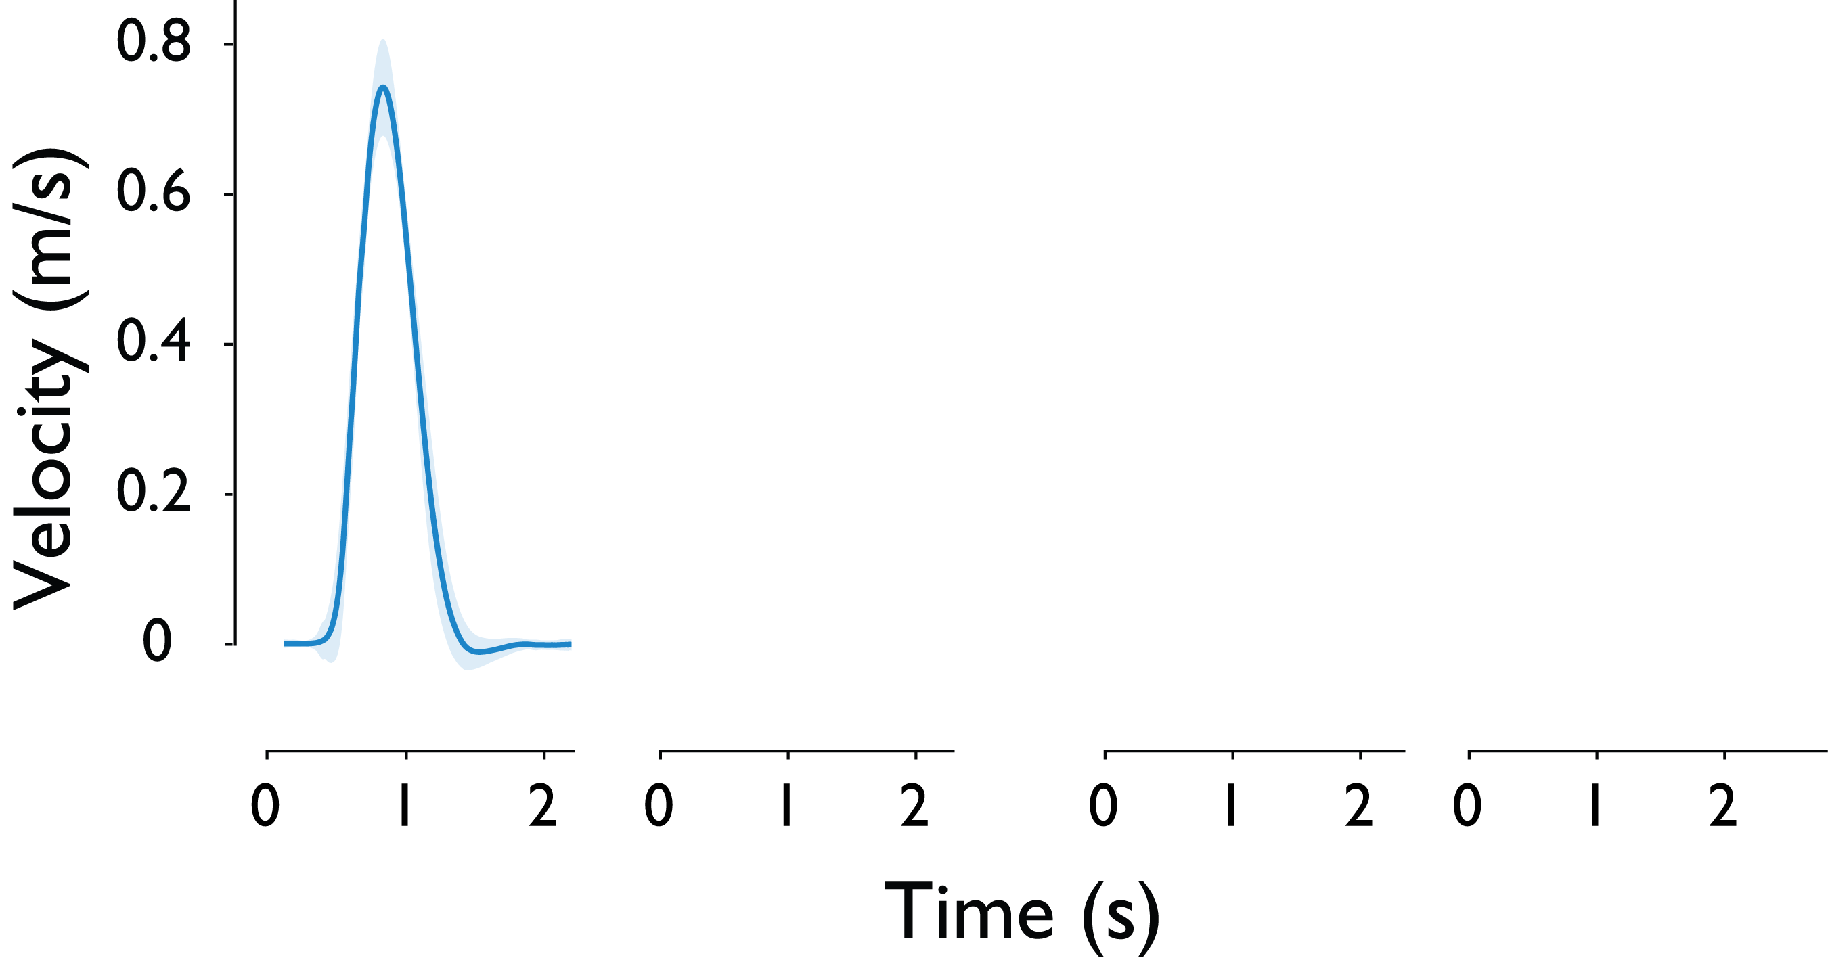
Velocity Profile

Slide 108
Velocity Profile

Slide 109
Velocity Profile – example subject (change)
Notes:
Use text (lots of dead space) to indicate the probes to remind audience
Even use protocol block on top to orient the audience
Use arrows to indicate which trials are shown from protocol diagram

Slide 110
Subjects increase vigor after history of low effort
$$ΔPeak Velocity={PV}_{low}^{probe} −{PV}_{high}^{probe}$$

Slide 111
Subjects increase vigor after history of low effort
$$ΔPeak Velocity={PV}_{low}^{probe} −{PV}_{high}^{probe}$$

Slide 112
Subjects increase vigor after history of low effort
$$ΔPeak Velocity={PV}_{low}^{probe} −{PV}_{high}^{probe}$$
Notes:
Might not be needed

Slide 113
Individual differences in vigor and relation to harvest behaviour
Notes:
This hasn’t quite been fleshed out yet. If I don’t get anything solid from my analysis I will nix this slide

Slide 114
Grip Ramp-up in Environment

Slide 115
Grip Ramp-up is Faster After History of Low Effort
Peak Force Rate (N/s):
On average subjects significantly increased their grip faster after a history of high effort.
Notes:
Peak force traces

Slide 116
Grip Ramp-up is Faster After History of Low Effort
Grip Ramp-up Duration (s):
On average subjects significantly increased their grip faster after a history of high effort.
Notes:
Should I just add stats here? I;m unsure

Slide 117
Giving-up Duration

Slide 118
When subjects stop collecting berries…
Notes:
Additionally, we know that subjects have to decide to stop harvesting berries and they reduce their grip force before moving out of the patch. We focus on the phase between the last berry and grip force reduction as the giving-up phase.

Slide 119
When subjects stop collecting berries…
Giving up Duration:
Duration since the last berry until force drops below threshold.
Notes:
We quantify this phase with the giving up duration.

Slide 120
When subjects stop collecting berries…
Giving up Duration:
Duration since the last berry until force drops below threshold.
Normalized to previous wait time.
Notes:
Grip ramp up duration may change depending on how long has been spent in patch. Therefore for a fair comparison, we normalize this metricto subject’s previous wait time.

Slide 121
Subjects take longer to give up in high effort environment
Giving up Duration:
Normalized giving-up duration increases overall in the high effort environment. (p=0.023)
Notes:
We find that subjects take a little longer to give up in the high effort environment, as opposed to the low effort environment.

Slide 122
Subjects take longer to give up in high effort environment
Giving up Duration:
Normalized giving-up duration increases overall in the high effort environment. (p=0.023)

Slide 123
Why we didn’t see a modulation in berry count?

Slide 124
Saliency of the audiovisual feedback might have made decision too explicit and routine.

